Slide 1
Stabilization of Kuttiyadi dam by providing supporting concrete structure on the downstream face and allied structures (Civil works) under DRIP II
Abhinand R S, Kerala WRD, INDIA

Slide 2
Stabilization of Kuttiyadi dam by providing supporting concrete structure on the downstream face and allied structures
SL. NO | CONTENTS | SLIDE NUMBER
1 | Introduction | 3-6
2 | Background of Proposal | 7-8
3 | Scope of work | 11
4 | Contract details | 12
5 | Kuttiyadi rehabilitation works | 13- 35
6 | Details of expenditure | 36
7 | Risk & Issues addressed | 37-38
8 | Balance work | 39
2

Slide 3
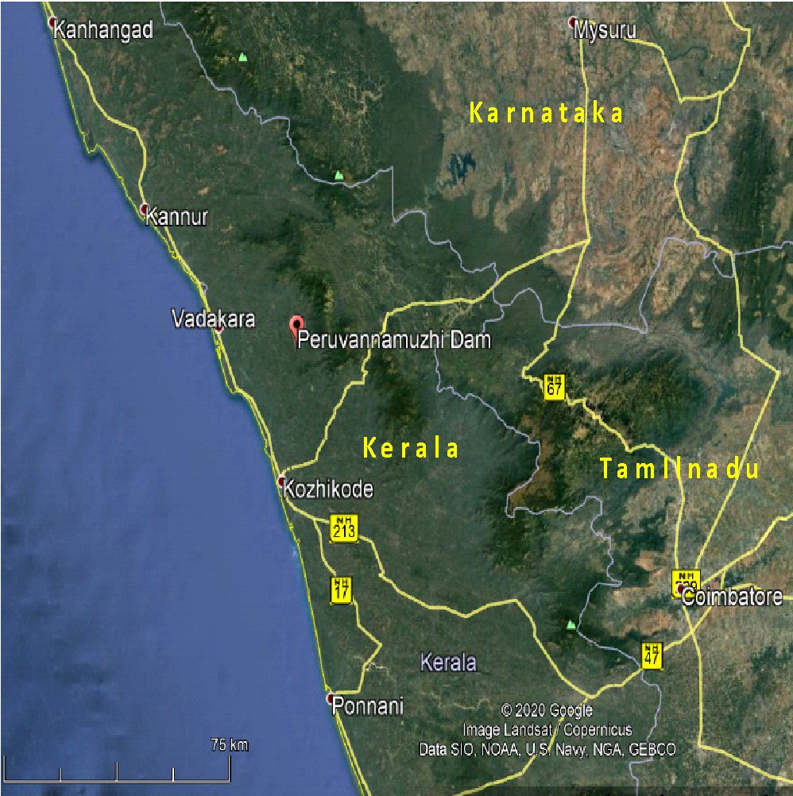
Kuttiyadi Irrigation Project
One and only Irrigation project in Kozhikode district
Gravity type stone masonry dam across Kuttiyadi river
Project started in 1962
Partially commissioned in 1973
Fully Commissioned in 1993
Water source for 3 taluks in Kozhikode district
Kozhikode
Koyilandy
Vatakara
Location of Kuttiyadi (Peruvannamuzhi) Dam
in Google Earth Image
3

Slide 4
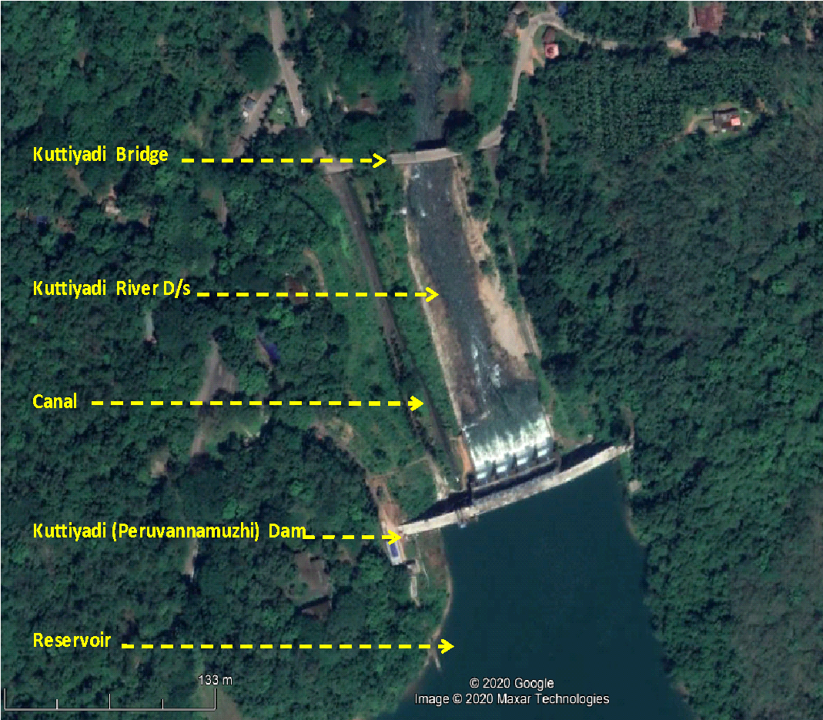
Kuttiyadi Dam
Gravity type stone masonry dam across Kuttiady river
Length of Masonry Dam -170 m
Maximum height of the gravity dam – 35.36 m
Water spread area - 1052 ha
Catchment area -108.78 square kilometers
10 Blocks
4

Slide 5
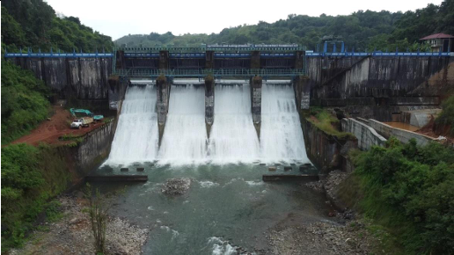
Kuttiyadi Dam-Salient Features
Spillways
4 Nos
Ogee spillway
Full Reservoir Level– 44.41 m
Maximum water level – 44.61 m
Spillway capacity – 1584m3/s
Outlet works
Canal sluice in block 4 of left non overflow portion
Total canal network length -603 Km
5

Slide 6
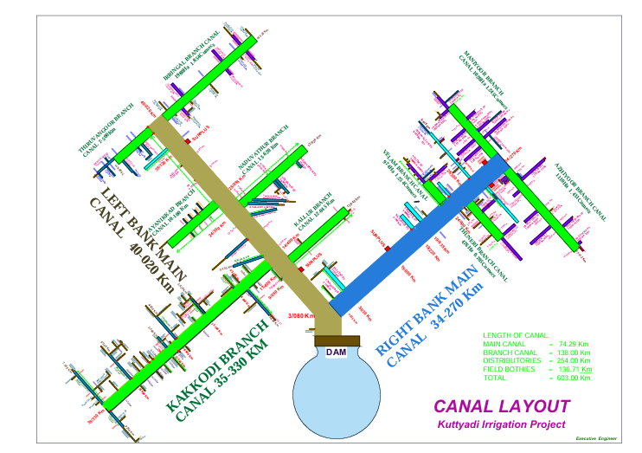
Kuttiyadi Irrigation Project
1
Main canal -3.08 Km
2
Left bank main canal – 40.02 Km
3
Right bank main canal-34.270Km
6

Slide 7
Background of proposal
Findings of expert committee
Tension will develop at heel if water is impounded up to FRL (ie. Up to 44.41m)
The dam was first impounded in 1973
The canal bank and a portion of the left river training wall were collapsed in the first flood in that year itself
For evaluating the structural safety of dam an expert committee of Chief engineers was constituted as per G.O(Rt)107/74/W&P dated 13.05.1974
During the period of this expert committee right side river training wall also collapsed
Recommendation of expert committee
To reduce the FRL by 0.9m which is being followed since then.
7

Slide 8
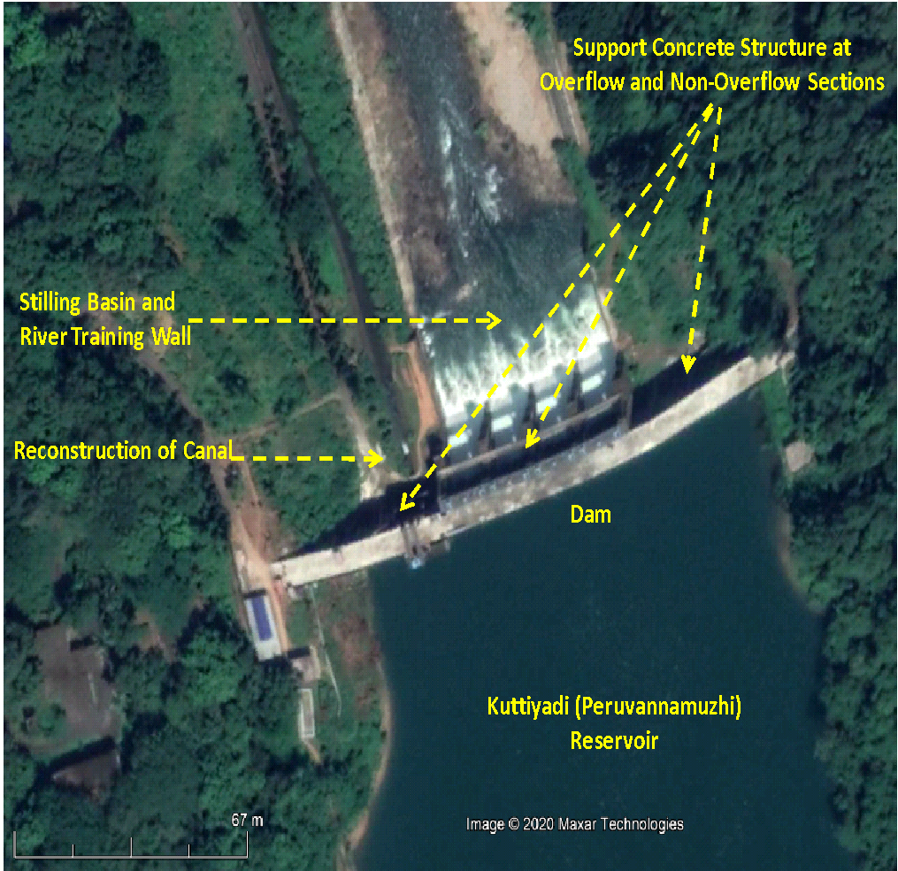
Background of proposal
In 1985 the Central Water Commission recommended a supporting backing concrete on the downstream face to stabilize the dam to raise the FRL to the original.
The implementation of this proposal was pending for the last 35 years due to paucity of fund and non finalization of design.
The work is now being implemented with the assistance of World Bank under the direct supervision of Central Project Management Unit (CPMU) under ‘Dam Rehabilitation and Improvement Project (DRIP)’.Phase II
8

Slide 9
Stabilization of Kuttiyadi dam by providing supporting concrete structure on the downstream face and allied structures
Two major criteria of consideration for design of this backing work is
Bonding Level (The maximum level up to which the reservoir can be impound during the course of construction of this backing work)
Compressive strength of existing Dam body.
The bonding level of the proposed work is
38.44m for overflow section
39.00m for non overflow section
Strengthening of Kuttiyadi (Peruvannamoozhi) dam and other saddle dams completed under DRIP phase I in the year 2020.
9

Slide 10
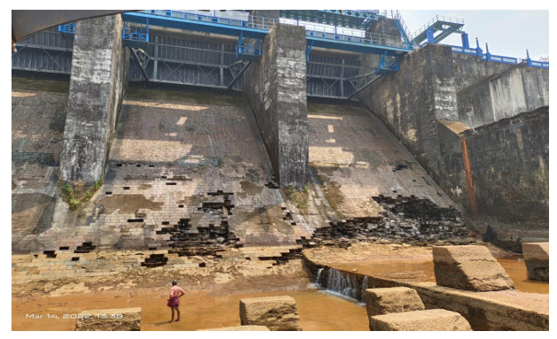
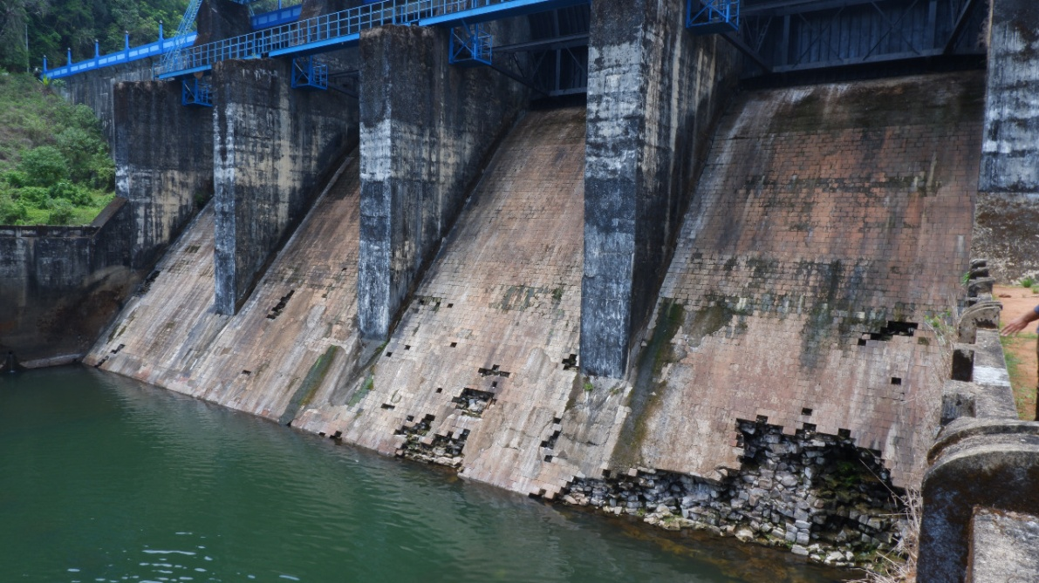
Stabilization of Kuttiyadi dam by providing supporting concrete structure on the downstream face and allied structures
10
Condition of overflow section before carrying out the DRIP Phase II work

Slide 11
Scope of work
Sl.No | Appendix | Proposed work | Remarks
1 | Appendix A Stilling basin and river training wall | Stilling basin extension by 10 m Reconstruction of River training wall
2 | Appendix B Supporting concrete structure in overflow sections | Supporting concrete works, chute blocks, shear key and anchoring work
3 | Appendix C Supporting concrete structure of non-overflow sections on the left bank | Supporting concrete works, Earth work excavation, shear key and anchoring works
4 | Appendix D Supporting concrete structure of non-overflow sections on the right bank | Supporting concrete works, Earth work excavation, shear key and anchoring works
5 | Appendix E Reconstruction of canal connected with dam ch 0/00 to 0/015km | Reconstruction of main canal
6 | Appendix F Reconstruction of road and garden | Reconstruction of Road and Garden
7 | Appendix G Dismounting Sluice shutter with hoist mechanism, Replacing damaged screw rod extension structure | Dismounting Sluice shutter with hoist mechanism, Replacing damaged screw rod extension structure | This appendix included after the sanction of Revised Estimate
11

Slide 12
Contract Details
AS order No | G.O (Rt) no.481/2020/WRD dated 22.07.2020 & G.O (Rt) no.539/2020/WRD dated 21.08.2020
AS amount | 3530 Lakhs
TS order No | 1/CE(I&D)/20-21 dated 24.08.2020 of CE,IDRB,Thiruvanathapuram
TS Amount | 3514 Lakhs
Agreement No | SE(C)07/2021-22 dated 29.11.2021
Name of Contractor | M/S Balaji constructions,Karjuve TQ,Sangameshwar dist., Ratnagiri,Maharashtra
Agreed amount | 3263.46 Lakhs
Site Hand Over | 30.11.2021
Time of Completion | 36 Months (ie.29.11.2024)
12

Slide 13
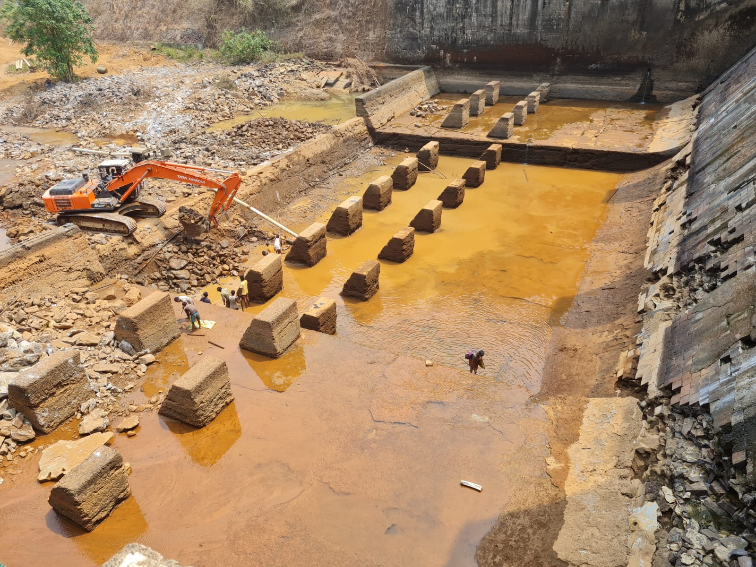
Stabilization of Kuttiyadi dam by providing supporting concrete structure on the downstream face and allied structures
Appendix A-Stilling basin and river training wall
Basic features of stilling basin
Stilling basin -size of 56.3m X 23.40m
Four bays , built in two levels
Outer two bays are at +16.50
Inner two bays are at +15.00 m
13

Slide 14
Appendix A-Stilling basin and river training wall (Contd..)
Retain the existing stilling basin as it is & put the supporting concrete structure of overflow section over it with shear keys
Extend the stilling basin by 10m equal to the width of the supporting concrete structure
River training wall to be extended by the same length as that of the extension length of the stilling basin.
14

Slide 15
Appendix A-Stilling basin and river training wall (Contd..)
For shearkeys- stones removed upto 60cm depth in a staggered manner along the longitudinal profile
For levelling of foundation ,proposed rock-wedging instead of diamond cutting
Cutting and leveling the rock in the same level for the entire length and breadth of the existing stilling basin.
Concreting is proposed to be carried out in a stepped manner keeping the minimum thickness of stilling basin
Execution is pending – awaiting of model study for repositioning of basin blocks for energy dissipation in stilling basin.
15

Slide 16
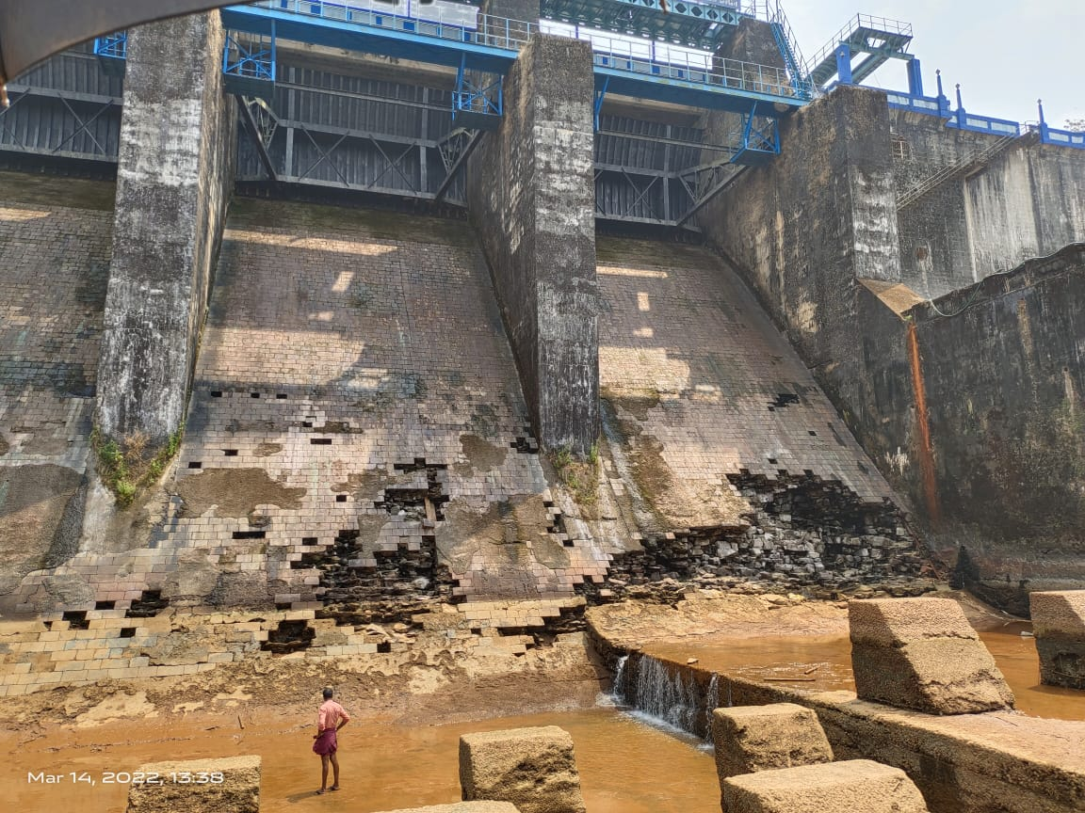
Appendix B-Supporting concrete structure of Overflow section
It has four bays -equal length of 12.20m each, with dividing concrete piers of 2.50m width in-between
The glacis portion externally appeared to be the most deteriorated portion of the Dam, with deep cavities formed due to the collapse of ashlar masonry
16

Slide 17
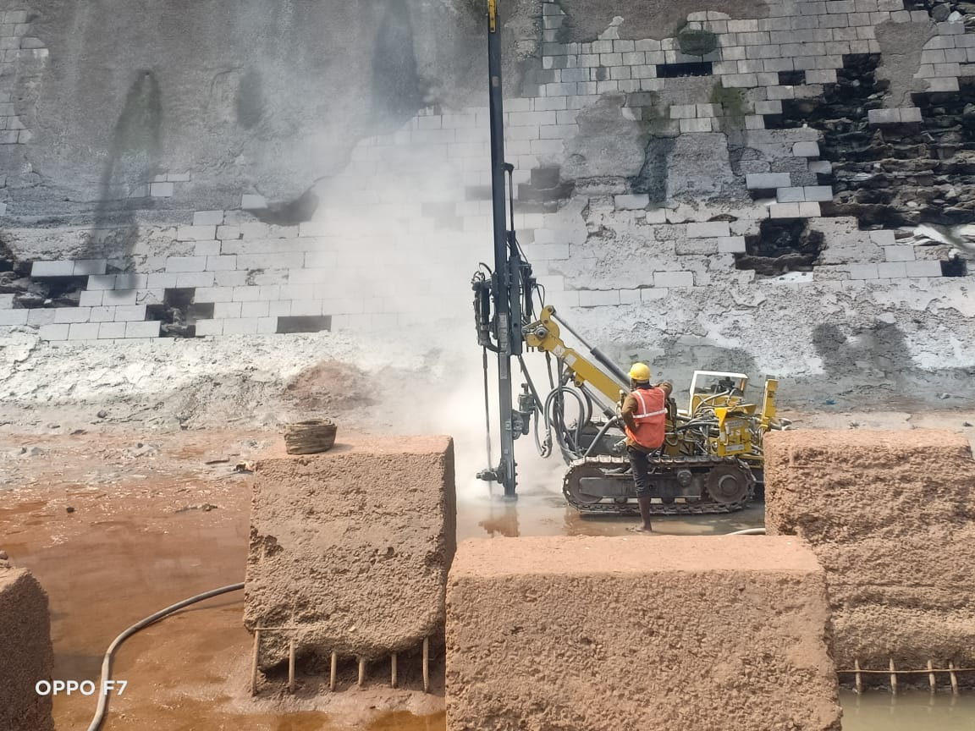
Appendix B-Supporting concrete structure of Overflow section (Contd..)
Work done
Removal of all the ashlar masonry on the glacis portion
Making groves for shear keys of 60X 60cm at 3m c/c in the longitudinal direction by removing stones without disturbing the other portions in the glacis.
Grooves for shear keys formed by diamond cutting in the founding portion of the stilling basin
The concrete portion in the crest has been diamond cut in ta stepped manner
Drilling of drainage holes of 50cm depth at 3m c/c both ways
Pressure grouting is done in the stilling basin portion
17

Slide 18
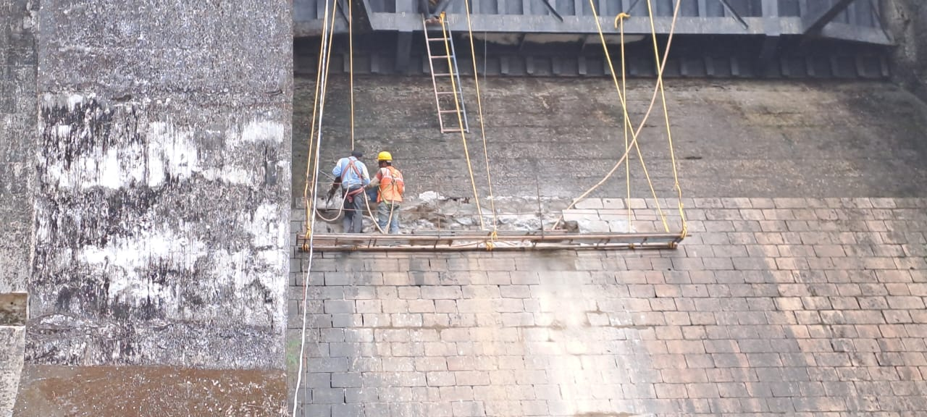
Appendix B-Supporting concrete structure of Overflow section (Contd..)
Work done
Cleaning surface with high pressure water jet both in dam body and in the founding portion of stilling basin
Anchoring of dowel rods both in the glacis portion and in the stilling basin
Placing 20cm half round PVC pipes over the dam body at 3m c/c both ways in such a way that the drainage holes would come exactly at the intersection of these pipes
Connecting these pipes to a full round 30cm PVC pipe at bottom to drain water into the stilling basin
18

Slide 19
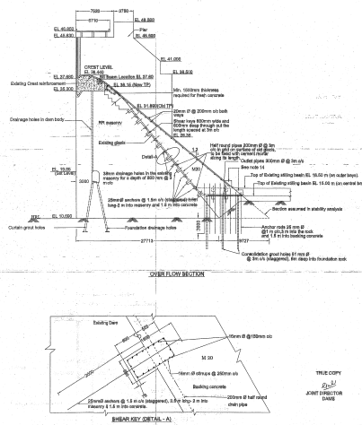
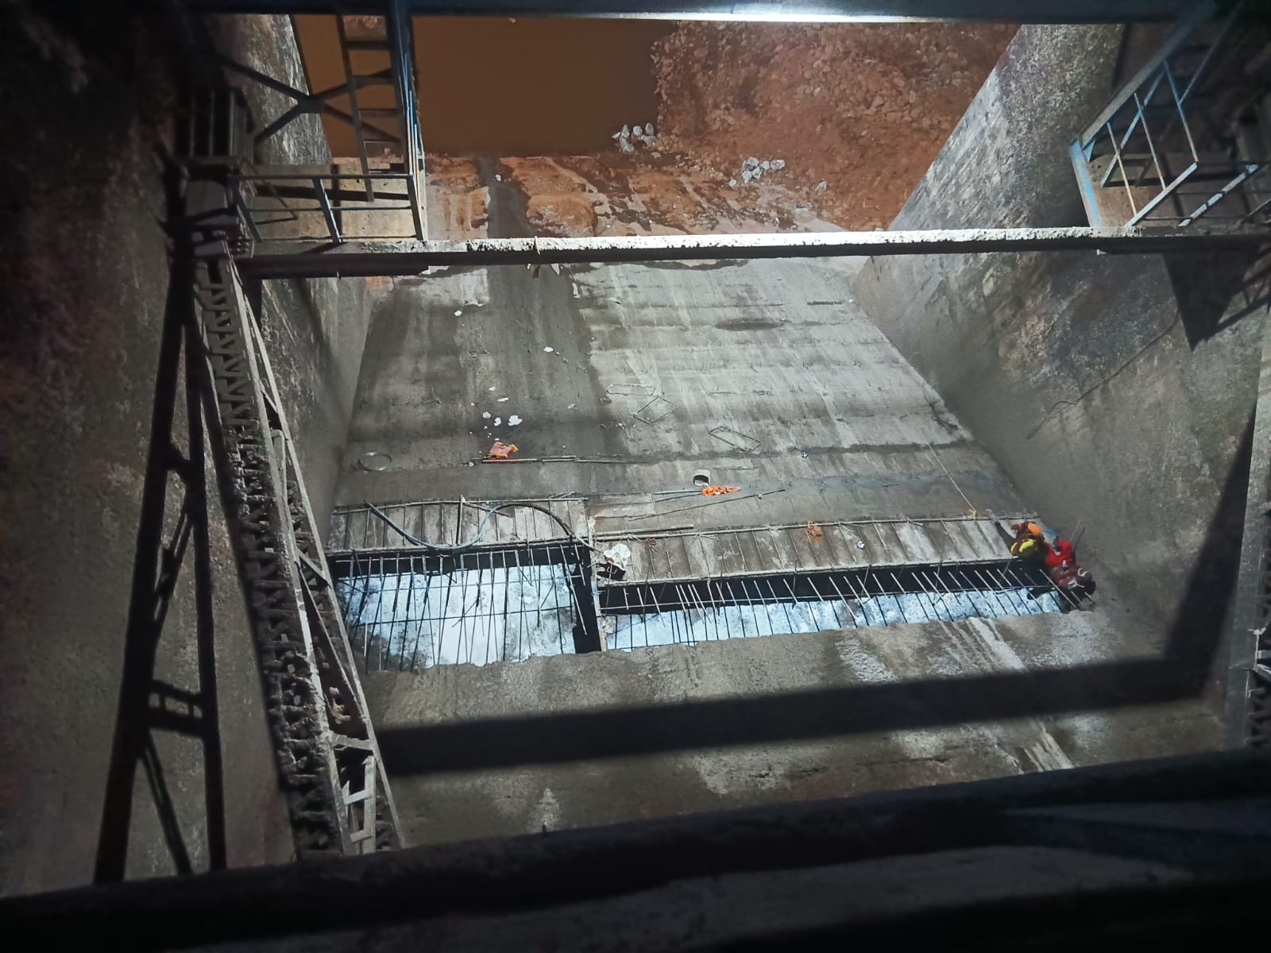
Appendix B-Supporting concrete structure of Overflow section (Contd..)
19

Slide 20
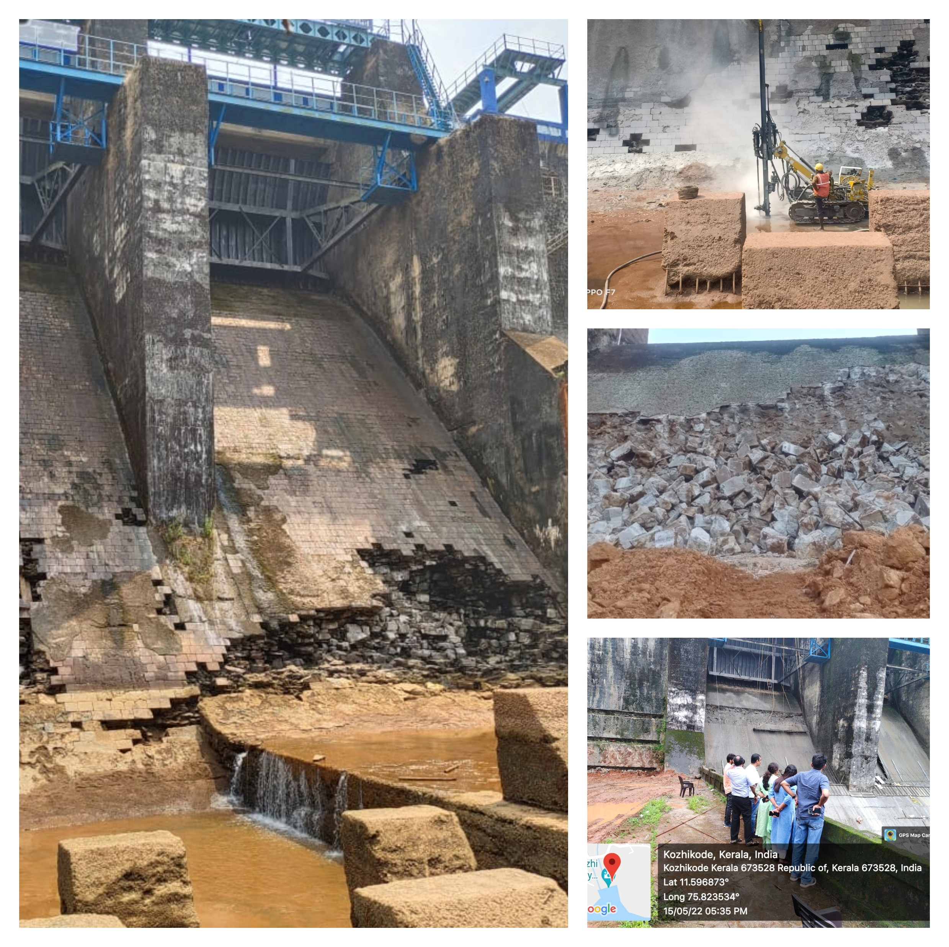
Appendix B-Supporting concrete structure of Overflow section (Contd..)
20

Slide 21
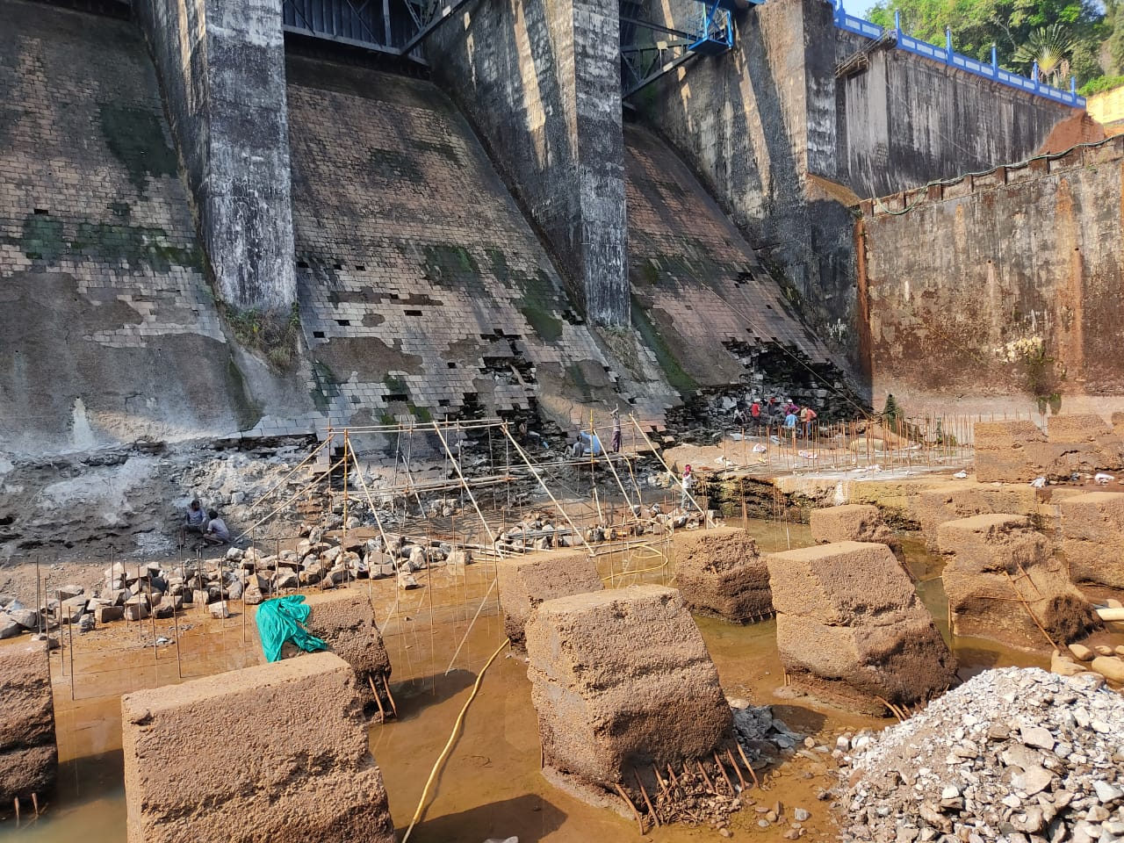
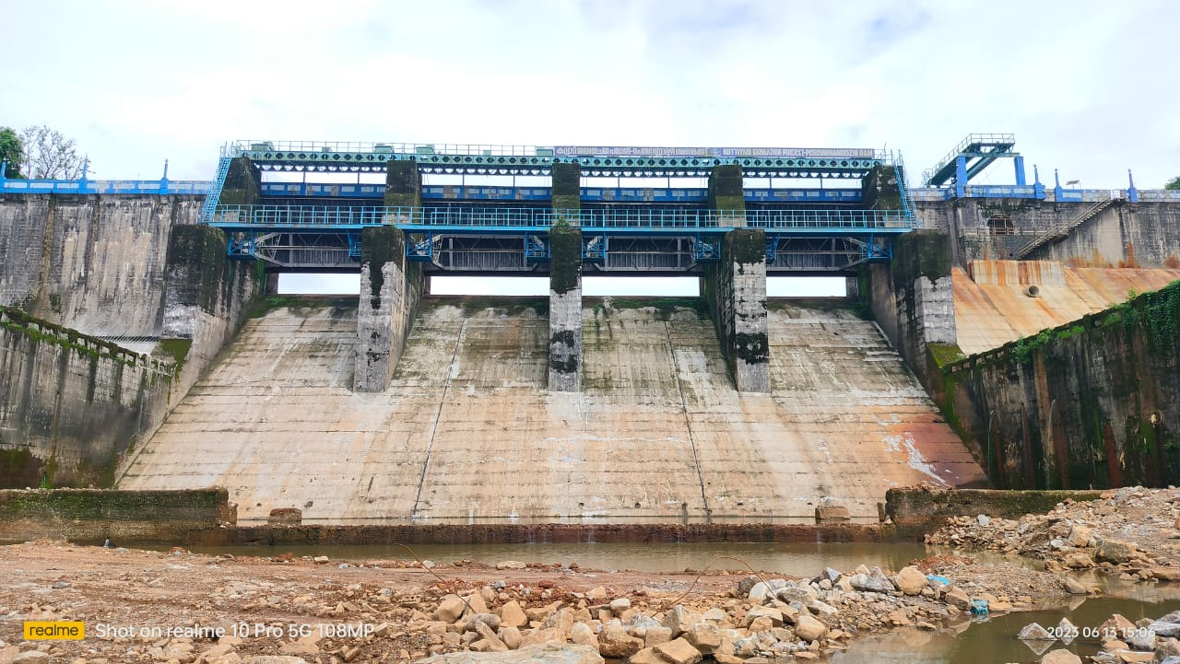
Appendix B-Supporting concrete structure of Overflow section (Contd..)
Picture of distressed location of overflow section on downstream of dam before the work
Picture of Supporting concrete structure in overflow sections after the work
21

Slide 22
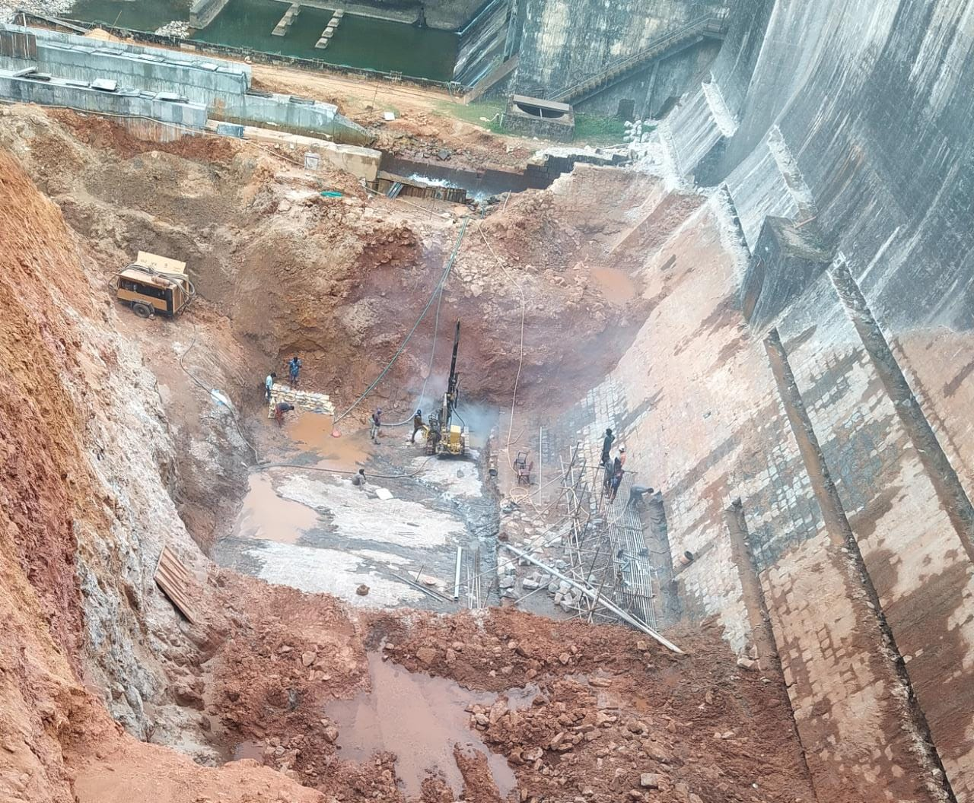
Appendix C-Supporting concrete structure of Non-Overflow
section on the left bank
Non-Overflow section on the left bank
Four blocks (Block 1 to 4)
Total length -63m
Canal sluice - Block 4
Gallery entrance - Block 3.
22

Slide 23
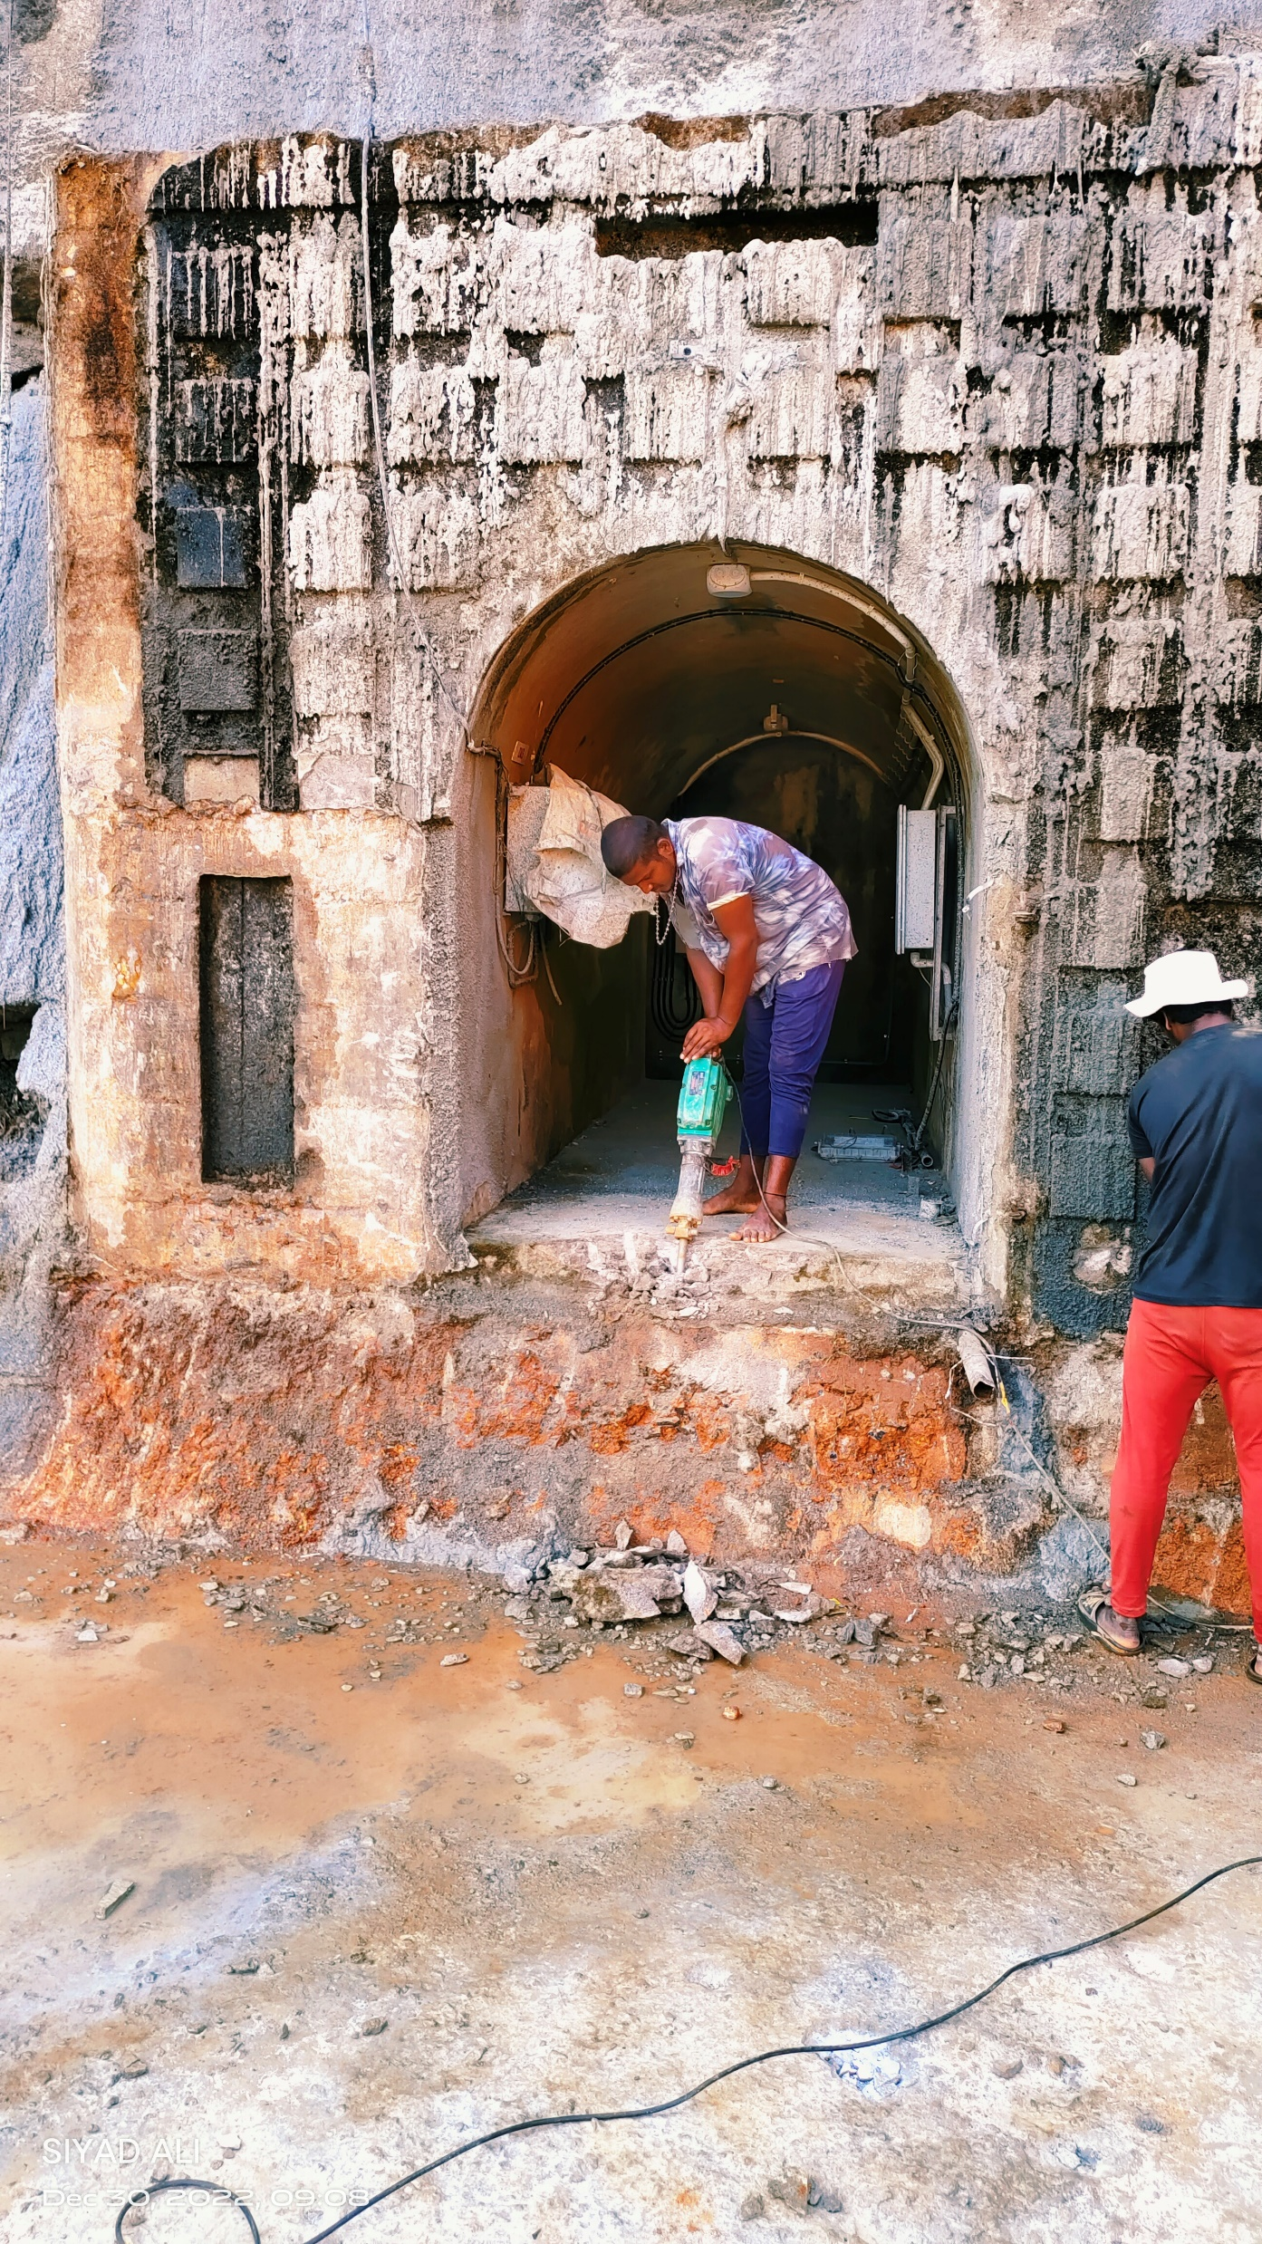
Appendix C-Supporting concrete structure of Non-Overflow
section on the left bank (Contd..)
Work executed
By back concreting up in block 3, new tunnel portion from sluice up to the exit point of Dam body is extended to the same width
the canal arrangement in the initial portion is shifted downstream correspondingly
The adit gallery also extended equal to the width of the supporting concrete structure
The sequence of execution is similar to that of the Overflow Section
23

Slide 24
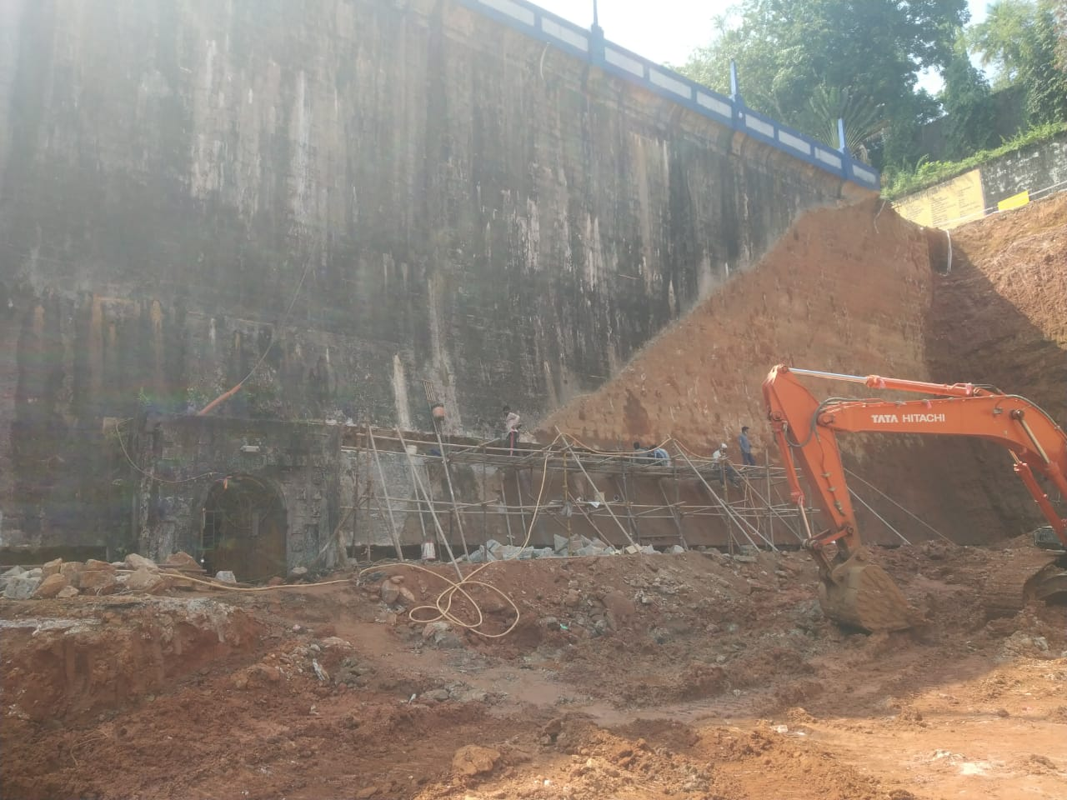
Appendix C-Supporting concrete structure of Non-Overflow
section on the left bank (Contd..)
Water collected in the PVC pipe will be discharged into a concrete drain and then discharged into the stilling basin through the training wall.
After completing the backing work of Non Overflow section, rubble pitching work on slopes and reconstructing Concrete steps and handrail, restored to the original shape
24

Slide 25
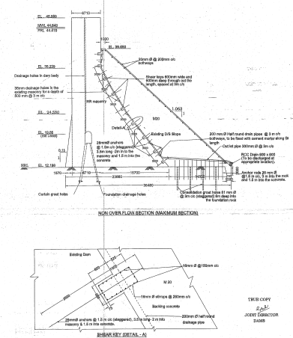
Appendix C-Supporting concrete structure of Non-Overflow
section on the left bank (Contd..)
25

Slide 26
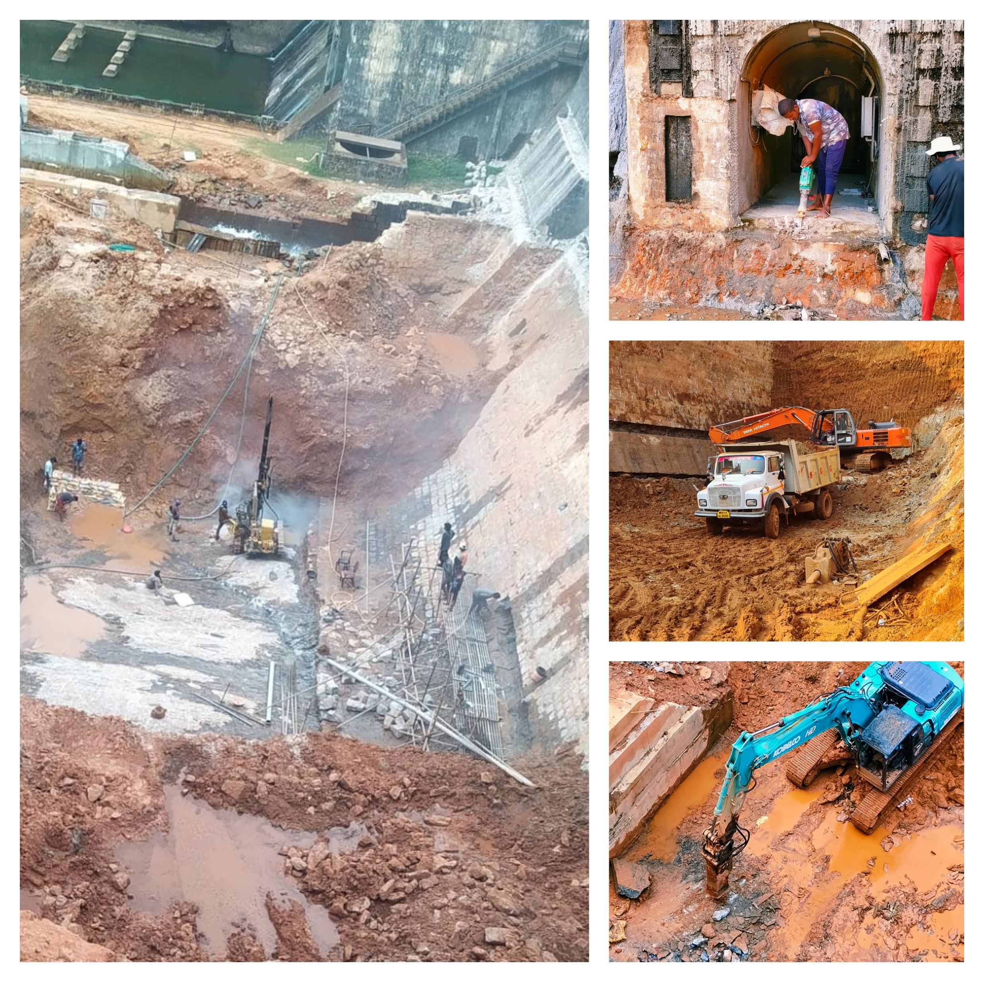
Appendix C-Supporting concrete structure of Non-Overflow
section on the left bank (Contd..)
26

Slide 27
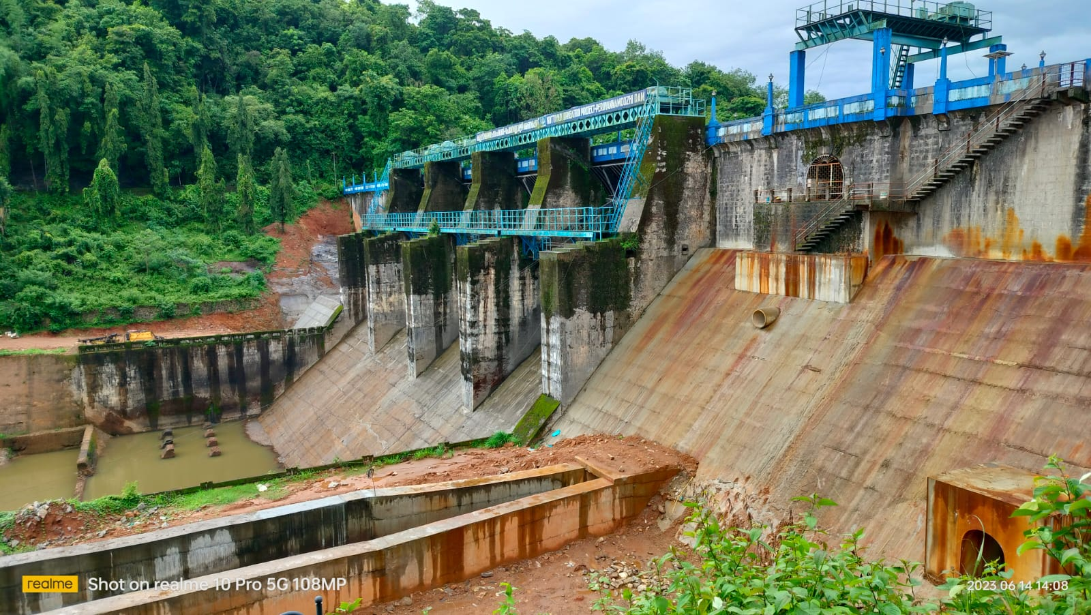
Appendix C-Supporting concrete structure of Non-Overflow
section on the left bank (Contd..)
Picture of Non overflow section on downstream of dam before the work
Picture of Supporting concrete structure in Non overflow sections after the work
27
27

Slide 28
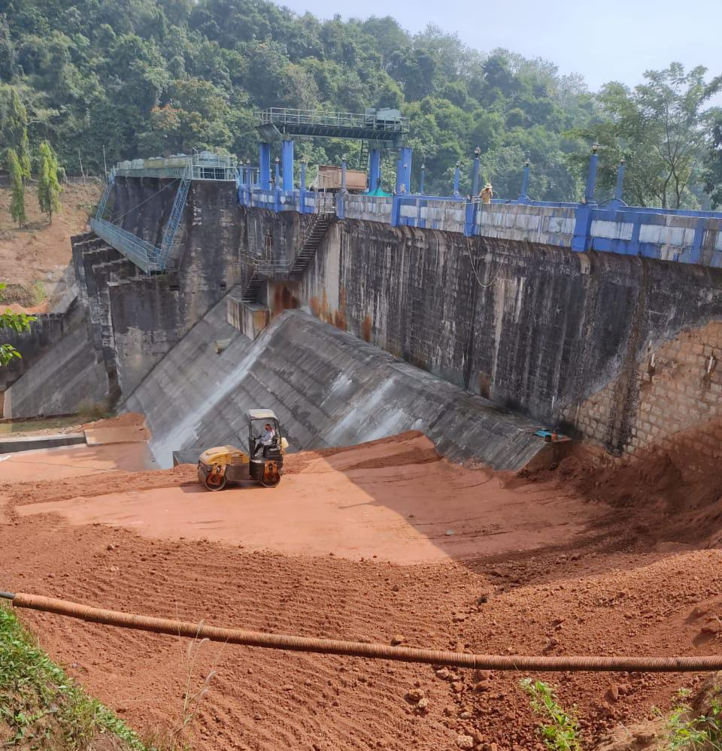
Appendix C-Supporting concrete structure of Non-Overflow
section on the left bank (Contd..)
Earth backfilling on the Left bank Non overflow section
Pitching work over the compacted earth on the left bank
28

Slide 29
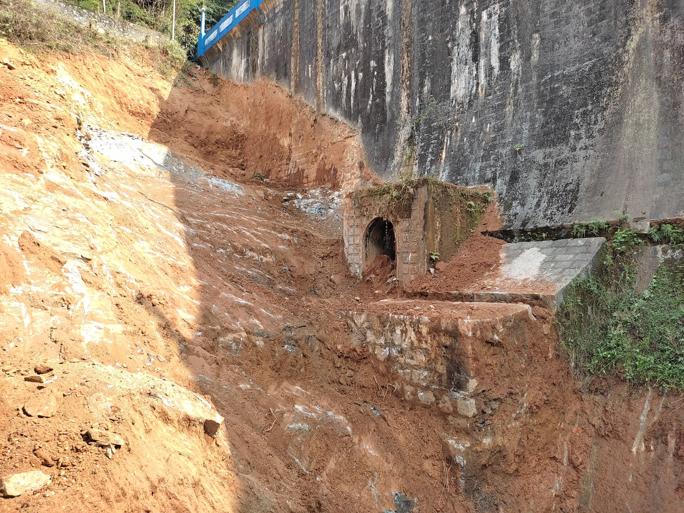
Appendix D -Supporting concrete structure of Non-Overflow section on the Right bank
Total three blocks
Length -53.70m
Backing work is proposed only for 48.00m , as the rock level is very high in the abutment portion of Block 10.
The adit Gallery in Block 9 is proposed to be extended
The method of execution -similar to that of the backing work in Left bank Non overflow sections
29

Slide 30
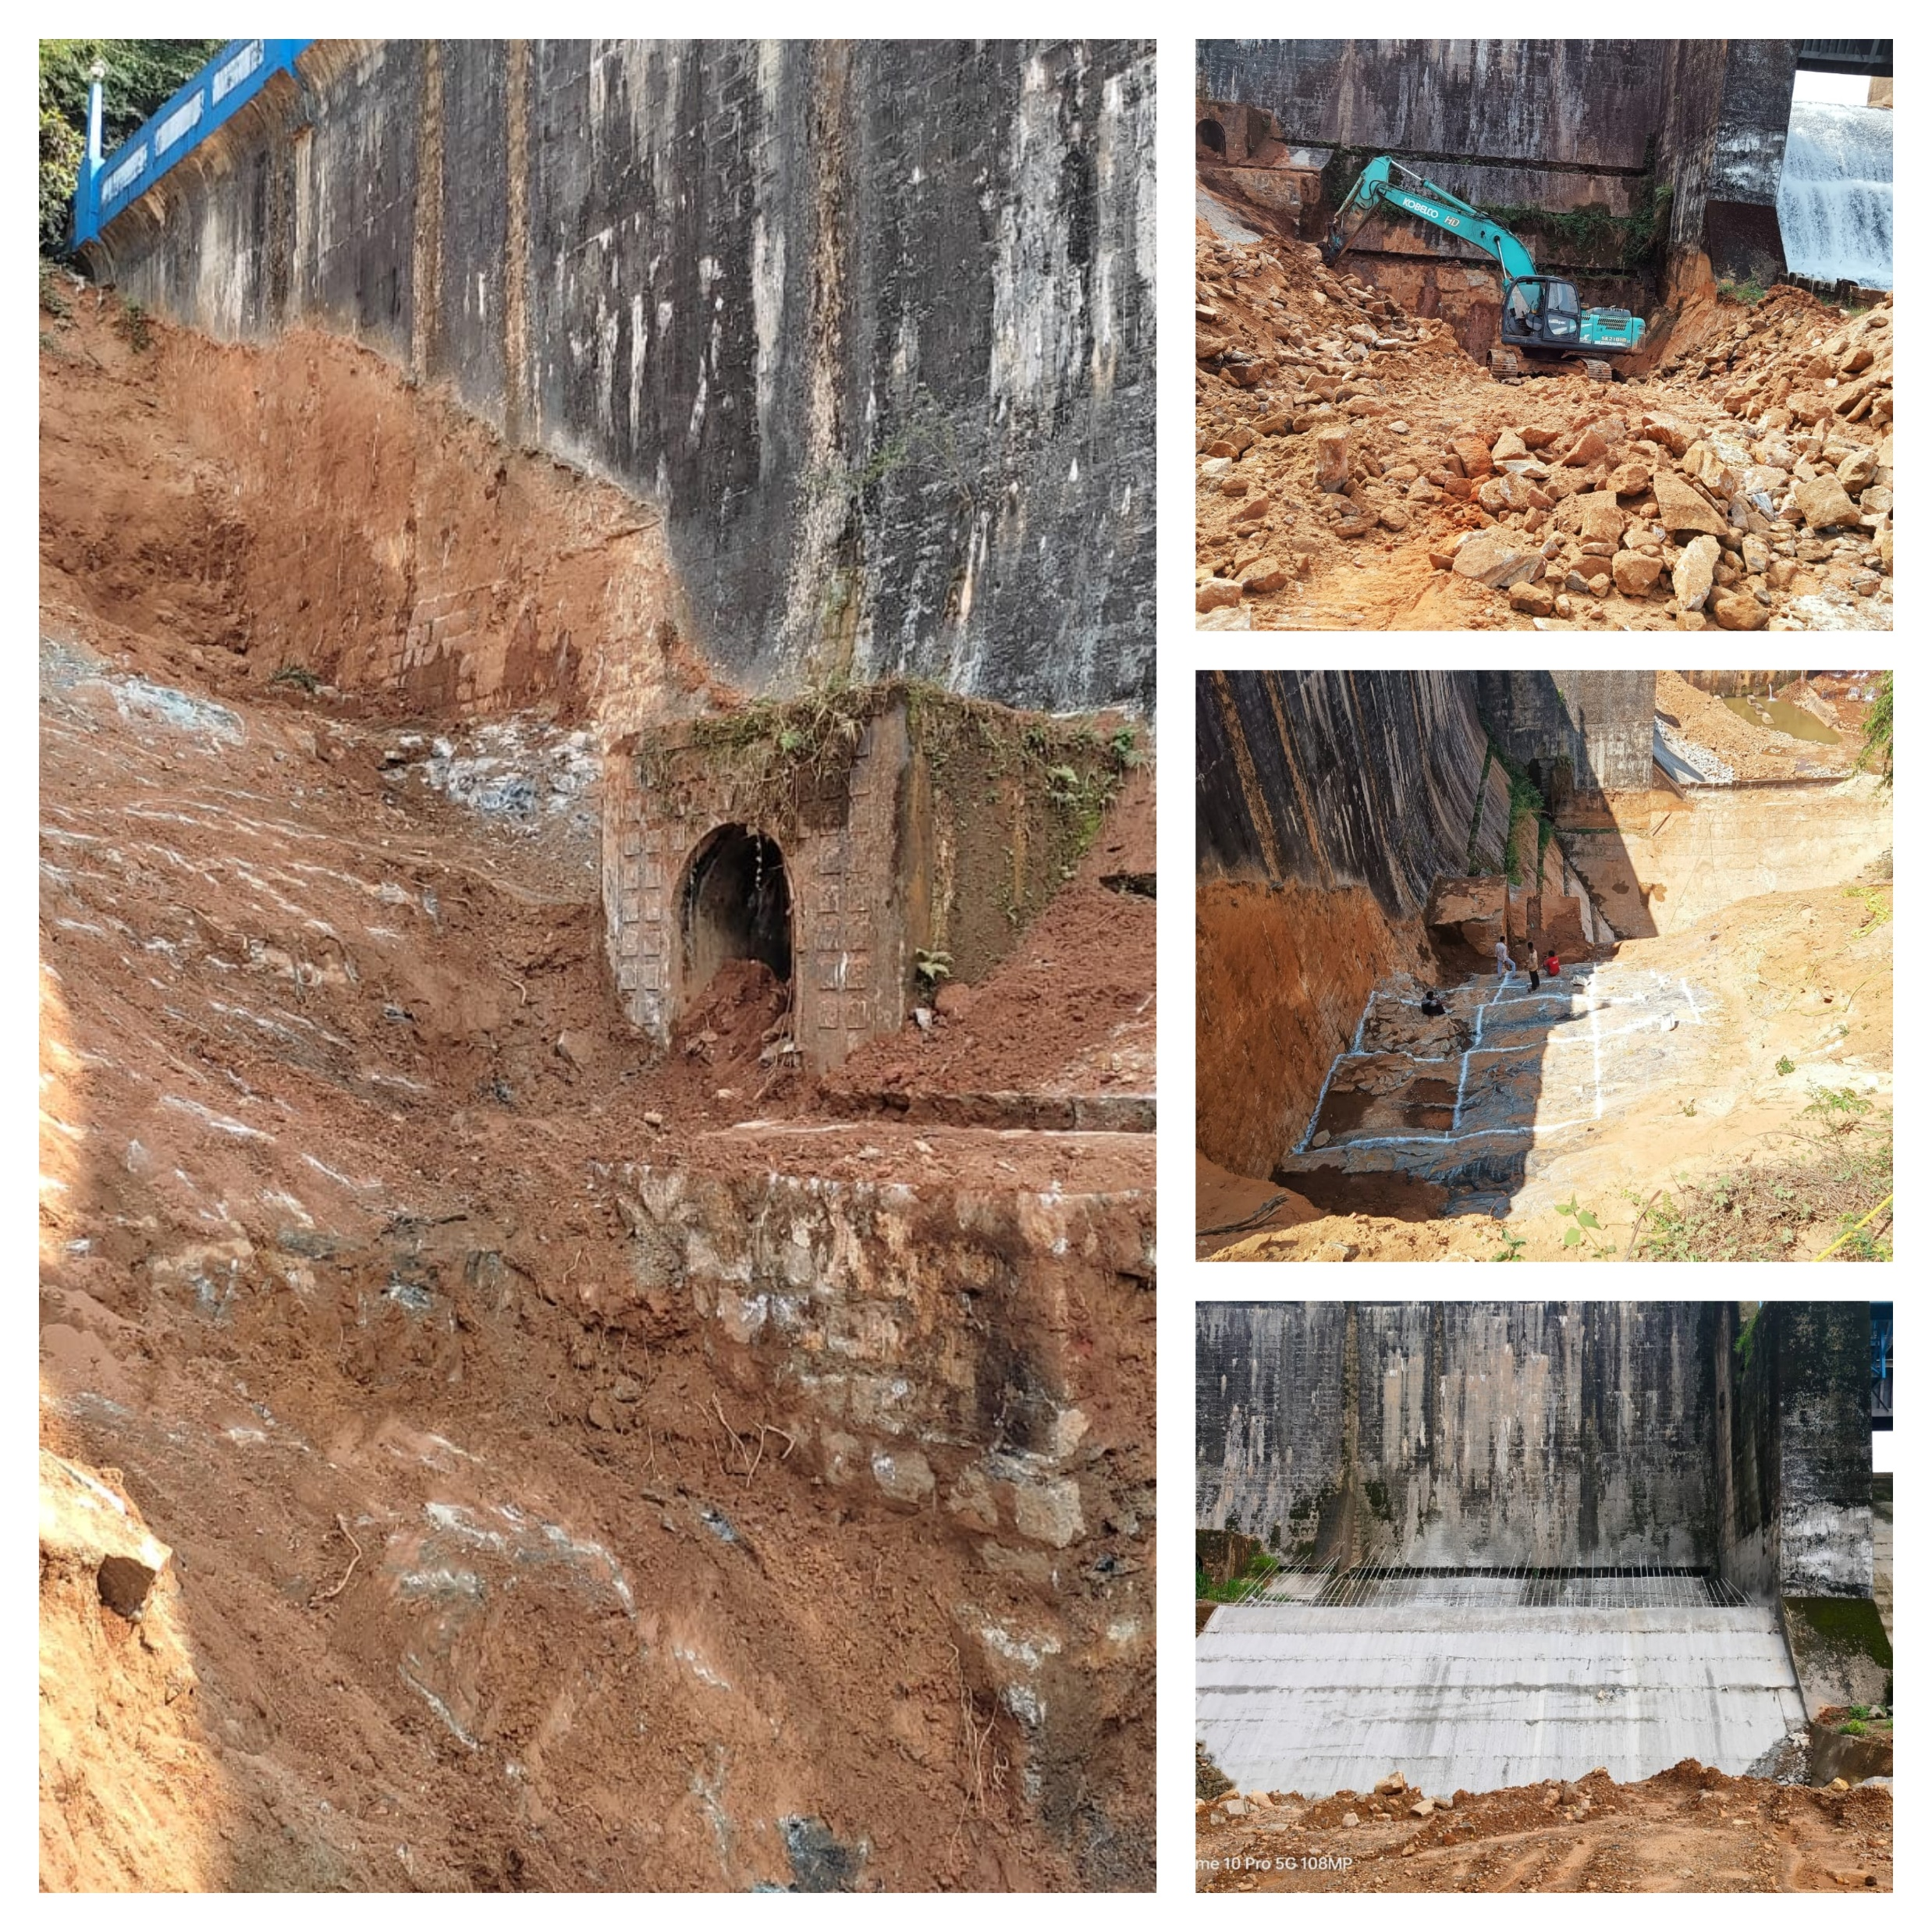
Appendix D -Supporting concrete structure of Non-Overflow section on the Right bank (Contd..)
30

Slide 31
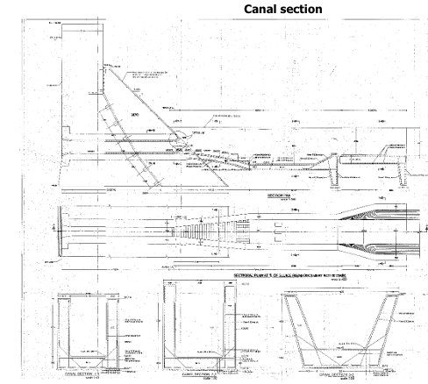
Appendix E -Reconstruction of canal connected with dam
Reconstruct the transition portion downstream of the stilling basin of the canal and to reconstruct the canal
31

Slide 32
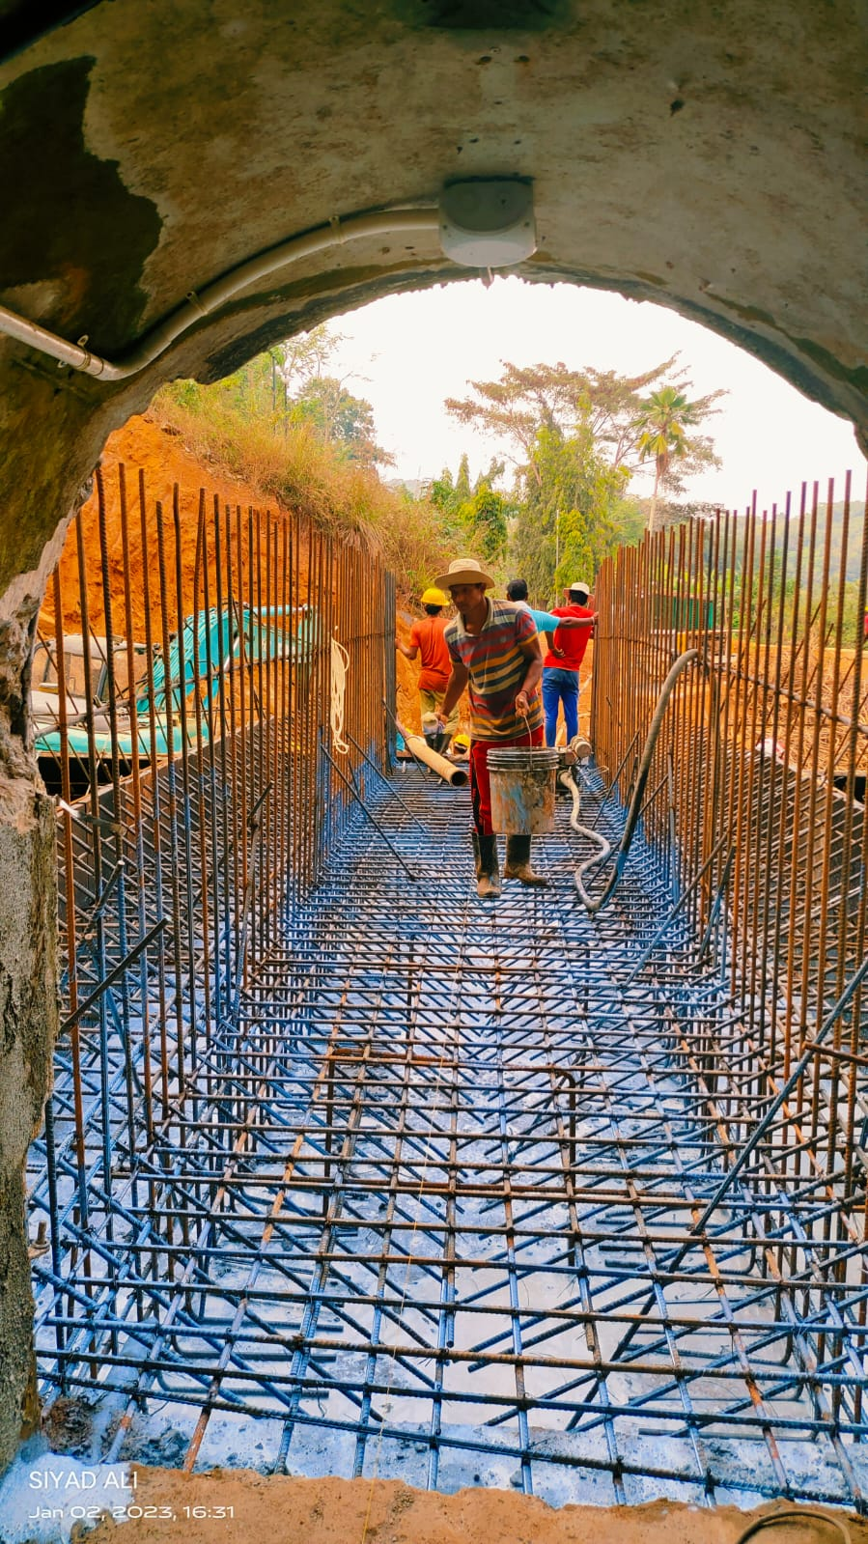
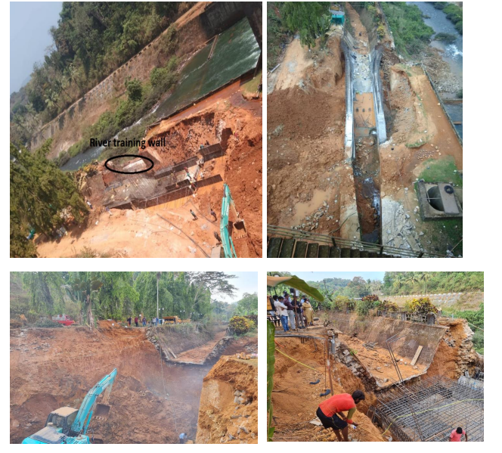
Appendix E -Reconstruction of canal connected with dam (Contd.. )
32

Slide 33
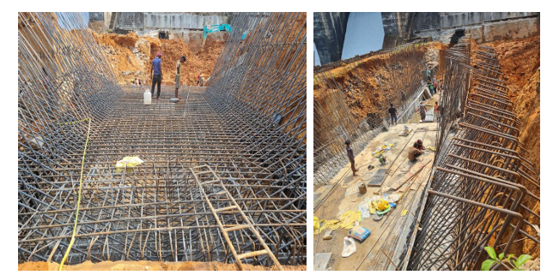
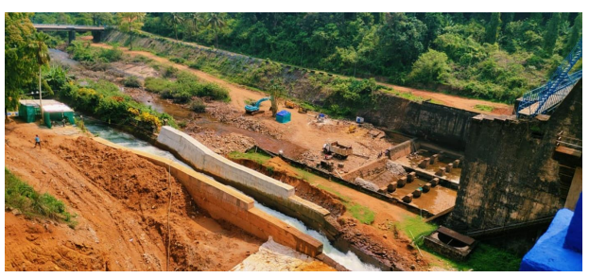
Appendix E -Reconstruction of canal connected with dam (Contd..)
33

Slide 34
Revised Estimate |  | Remarks
Revised Estimate order No | 6/CE(I&D)/22-23 dated 19.11.2022 of CE,IDRB,Thiruvanathapuram
Revised estimate amount w.r.to estimate | 3627.63 Lakhs (3.23% above of original estimate amount)
Contact amount | 3367.78 Lakhs (3.19% above of original contract amount) | Original estimate GST is 12% Revised estimate sanctioned by including 18% GST
Revised Estimate due to GST hike
Revised estimate amount | 3488.96 Lakhs
Contact amount | 3314.51 Lakhs (1.56% above of agreed amount)
34

Slide 35
Progress report as on August 2024
Sl No | Activity | Physical progress (%) | Financial progress (%) | Description of Physical achievement
Appendix A | Stilling basin and river training wall | 15% | 11% | Training wall partially done
Appendix B | Supporting concrete structure in overflow sections | 98% | 98% | Physically Work completed (In anticipation of approval of second Revised Estimate)
Appendix C | Supporting concrete structure of non-overflow sections on the left bank | 89% | 85% | Block 1,2,3 & 4Completed.Earth back filling had been completed. Pitching work completed
Appendix D | Supporting concrete structure of non-overflow sections on the right bank | 52% | 35% | concreting of 8th block was completed up to 98%
Appendix E | Reconstruction of canal connected with dam ch 0/00 to 0/015km | 69% | 69% | Canal work completed .
Appendix F | Reconstruction of road and garden | 0% | 0% | Not started. The work will carried out after the completion of Right bank Non overflow section
Appendix G | Dismounting Sluice shutter with hoist mechanism, Replacing damaged screw rod extension structure | 100% | 0% | Mechanical Work is completed.
Total Physical Progress |  |  | 73%
35

Slide 36
Details of Expenditure
Bill Type | Bill submitted to CE | Bill amount
CC 1st part bill | 10.03.2022 | Rs. 1,96,06,060/-
CC 2nd part bill | 02.07.2022 | Rs.4,52,11,171/-
CC 3rd part bill | 20.10.2022 | Rs.3,42,93,047/-
CC 4th part bill | 24.02.2023 | Rs.6,17,07,799/-
CC 5th part bill | 28.04.2023 | Rs. 2,51,05,825/-
CC 6th part bill | 14.08.2023 | Rs. 3,76,12,314/-
Total Bill paid |  | 2235.36 Lakhs
Financial Progress |  | 67.95%
36

Slide 37
Risk & Issues to be addressed
The initial proposal was to extend the stilling basin by 10m, equal to the width of the supporting concrete structure, with the training wall also extended by the same length.
However, it was observed that hydraulic jump was forming further downstream, impacting the energy dissipation mechanism.
Decided to proceed with the extension of the stilling basin and training wall after the completion of the hydraulic model study currently underway at KERI Peechi.
37

Slide 38
Risk & Issues to be addressed
2. The inspection gallery tunnel concrete work in non overflow section of Right Bank
Hard Rock encountered at the opening of tunnel mouth
Blasting/ Chemical demolition was not practical causing delay in backing work at the Right Bank Overflow Section
38

Slide 39
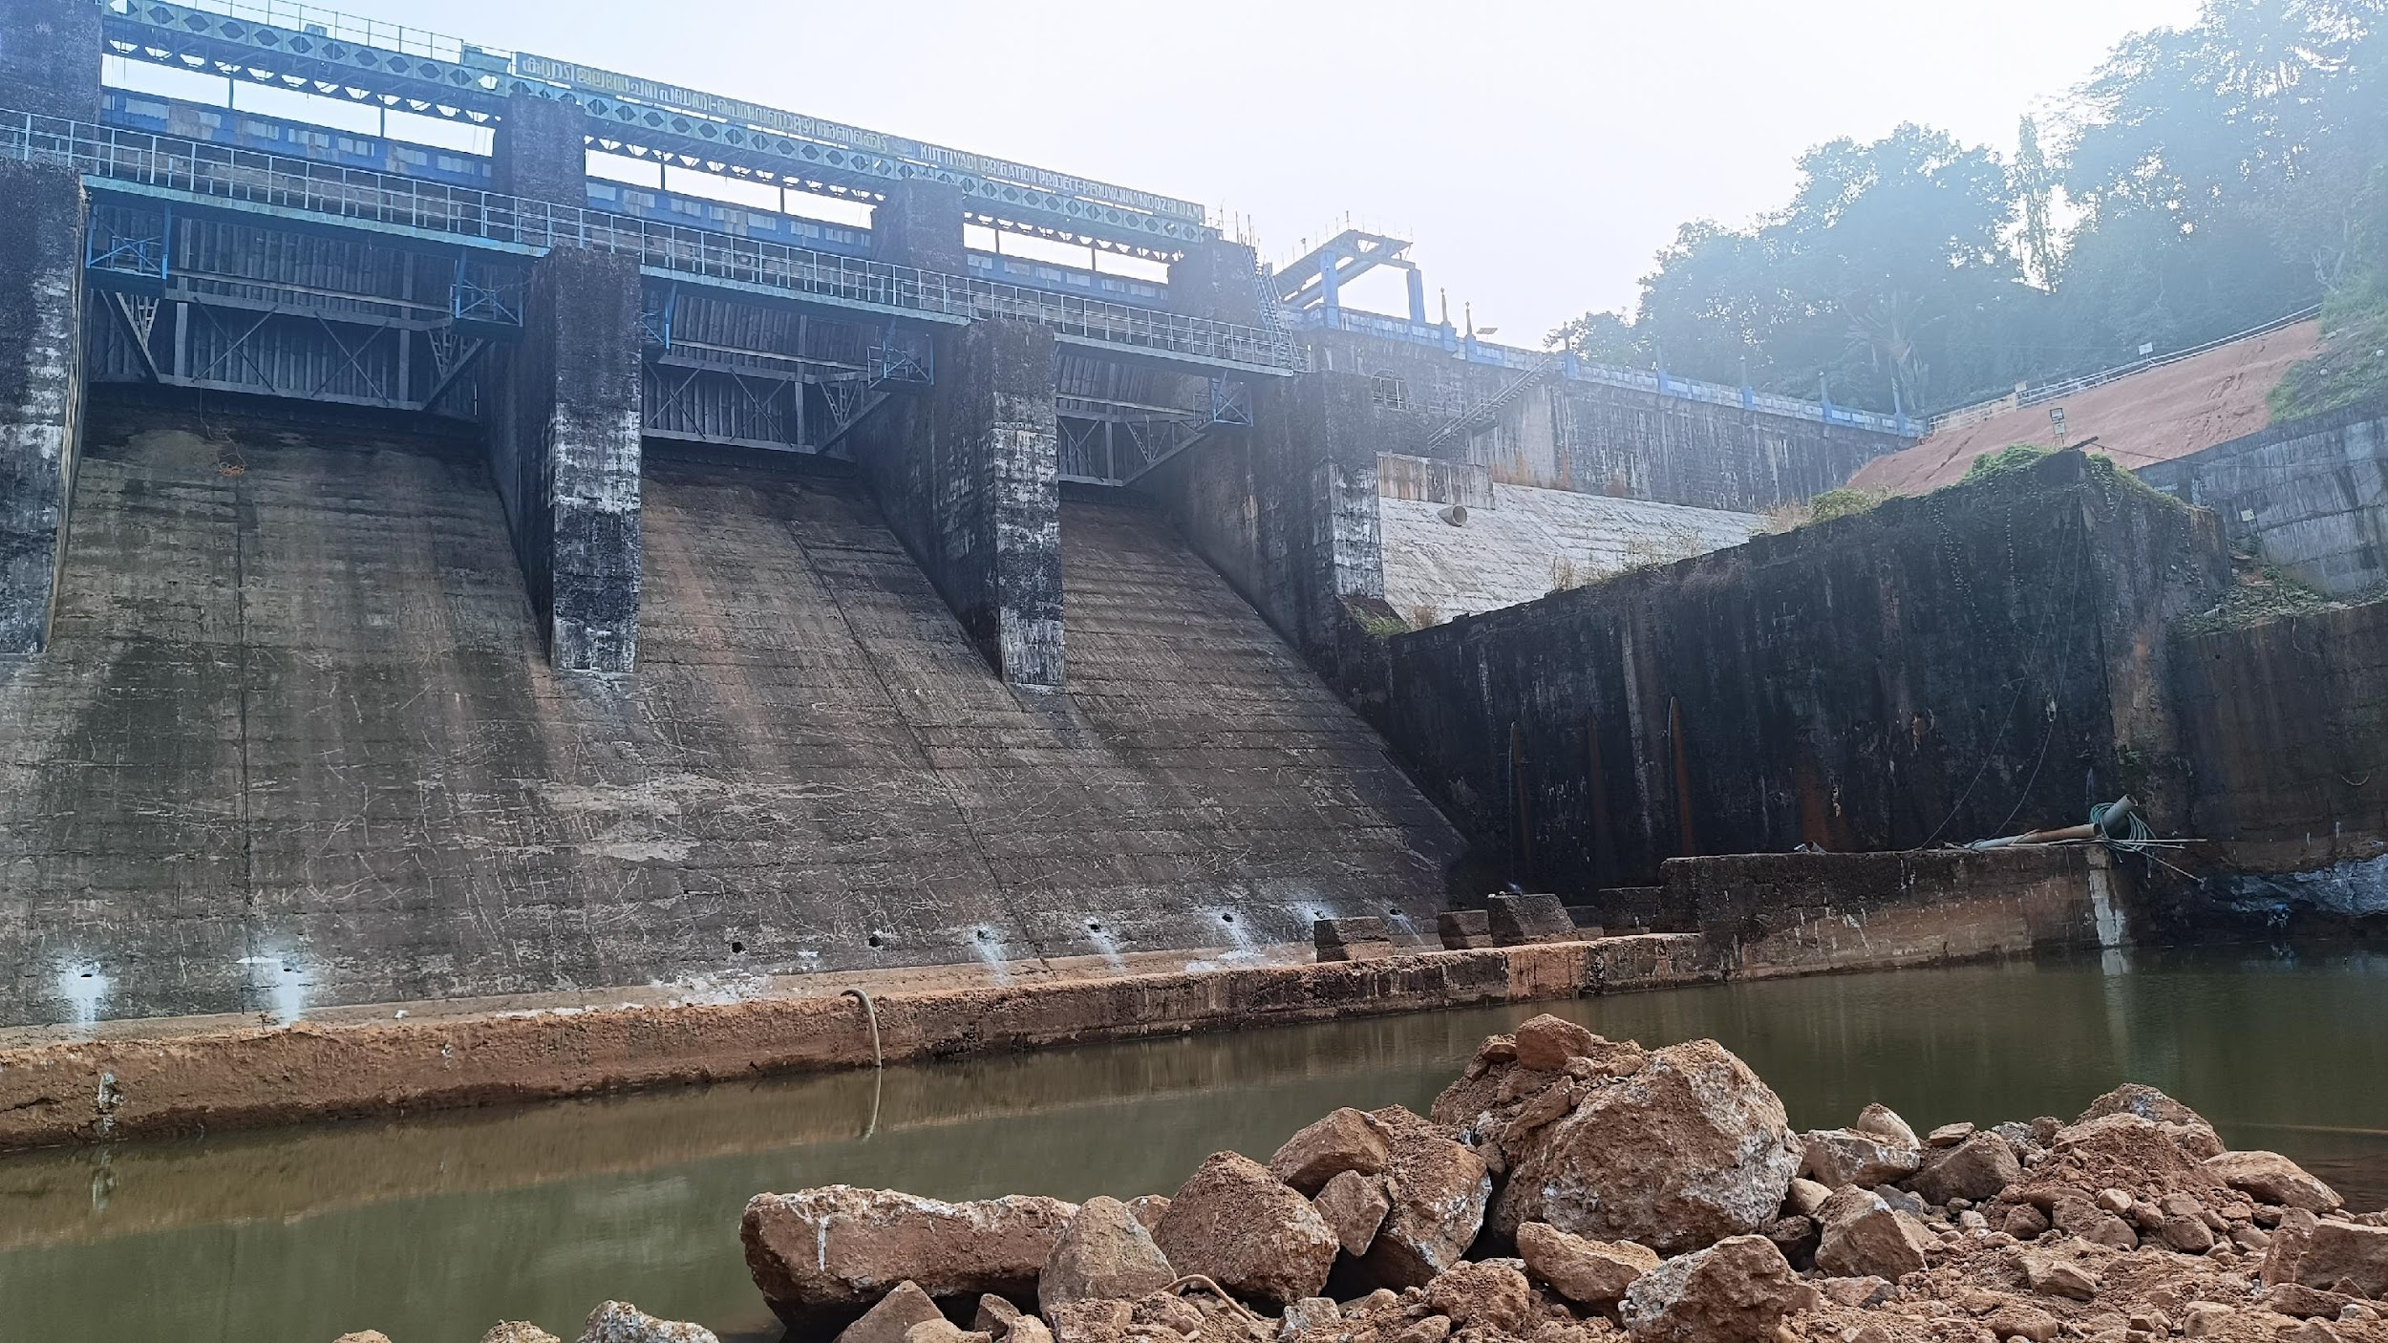
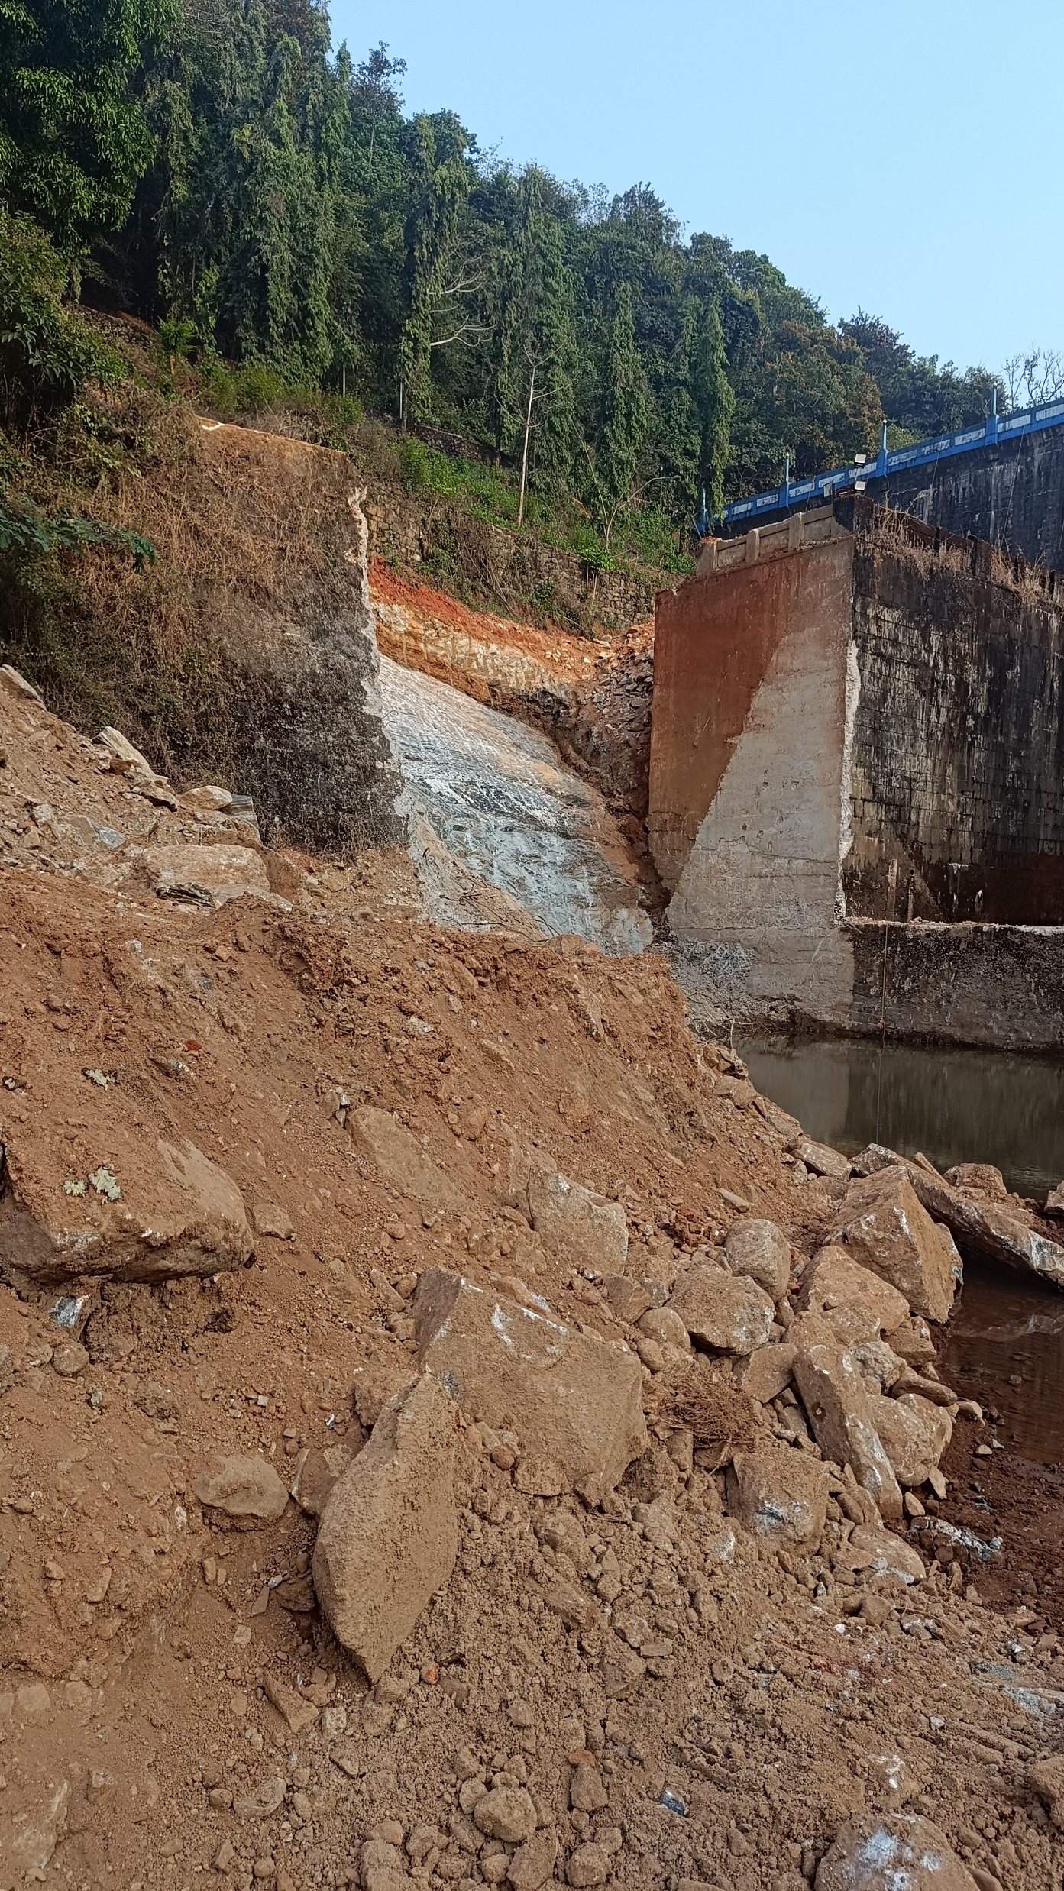
Balance work
App A- Extension of Stilling Basin & Balance portion of Left training Wall
To be taken up after completion of Hydraulic Model Study, currently underway at KERI Peechi.
39

Slide 40
THANK YOU

