Slide 1
CHALLENGES ENCOUNTERED DURING IMPLEMENTATION OF DRIP
Name: B. Wann, Organization : MePGCL, COUNTRY : India

Slide 3
UMIAM STAGE-I CONCRETE DAM

Slide 4
MAJOR CIVIL WORKS CONTRACTOR: M/s ITD CEMENTATION INDIA LTD.
Cracks Repairing on Upstream Face of Dam
Grouting of dam foundation from foundation gallery
Reaming/ Re-drilling of drainage holes
Activities that require no traffic flow
Drilling/ Reaming of Formed drains from Dam top
Drilling and Grouting of dam body from Dam top
Treatment of Contraction joints in the NOF
Relaying of cement concrete over the dam top

Slide 5
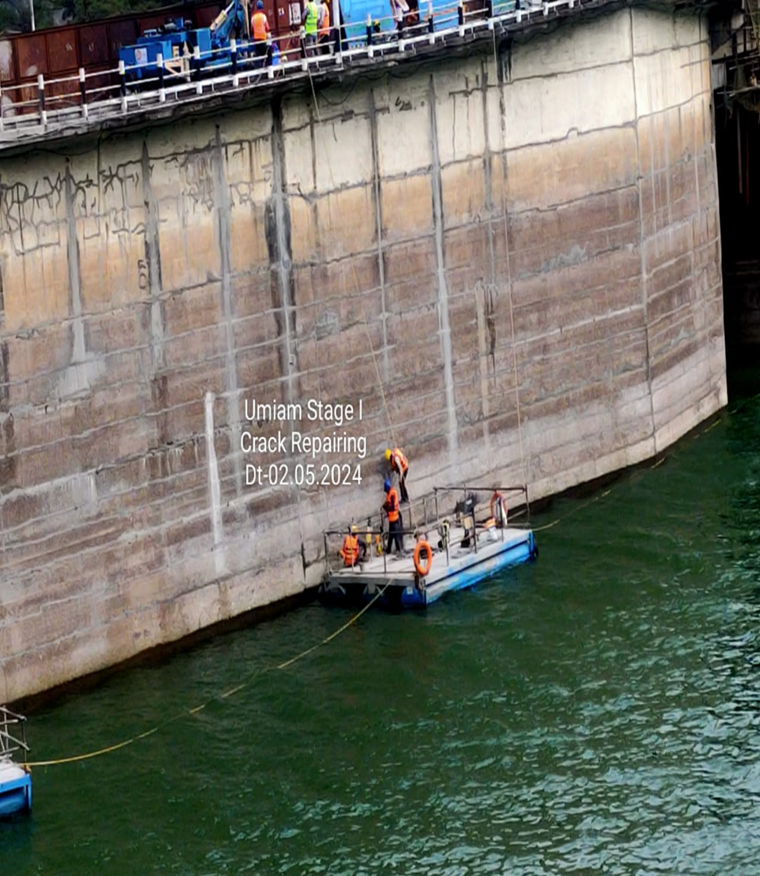
CRACKS REPAIRING ON UPSTREAM FACE OF DAM
Lowering of water level to EL 3166Ft -by the Power Management of MeECL
Grouting of cracks through nozzles with grout mix with Micro-fine cement
Pontoon

Slide 6
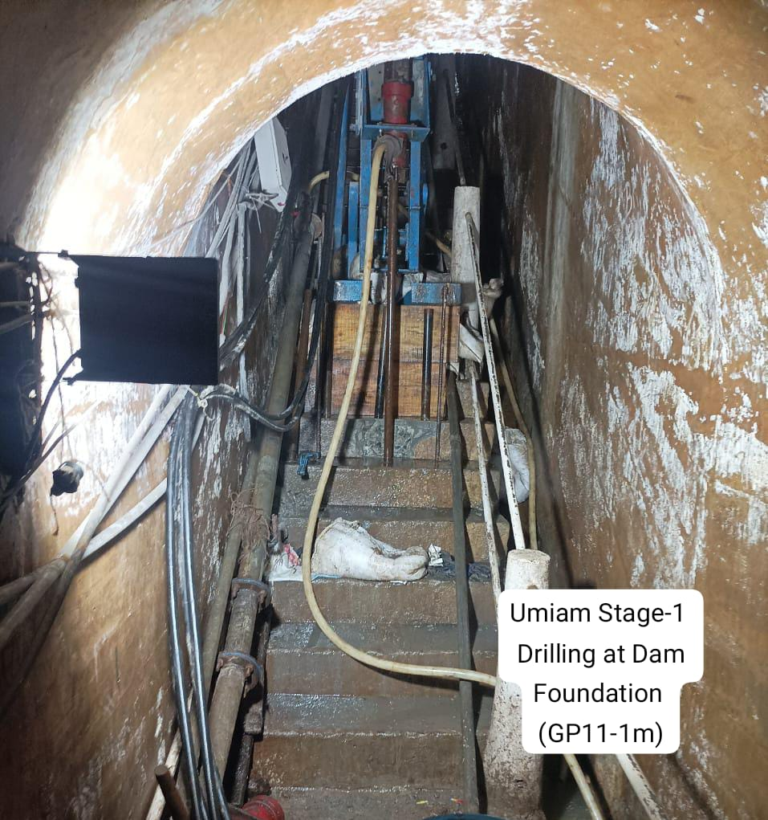
Curtain Grouting of Dam Foundation from foundation gallery
Restricted space in
foundation gallery-
Suitable Drilling
machines.
Difficulty in Placement
of machines due to
lengthy flights with less
intermediate landings

Slide 7
Barricading/Half Road Closure of NH 6 w.e.f 14th December 2023 to 30th July 2024
NH 6 is a highway passes over the dam top in the state of Meghalaya connecting with States Assam, and Mizoram
Faced hurdles in Operation & Maintenance of Dam in the past years.
Decision for partial closure taken by the District administrations
Partial closure of Highway raised protests from all walks of life but no complaints in the GRM
Management of Traffic was being carried out by the District Police

Slide 8
Treatment of Contraction joints
Exact location of water stops cannot be located, not indicated in the old drawings
Treatment of contraction joints by drilling 150mm ɸ hole along the Dam body joints and filling the hole using hydrophilic polyurethane material

Slide 9
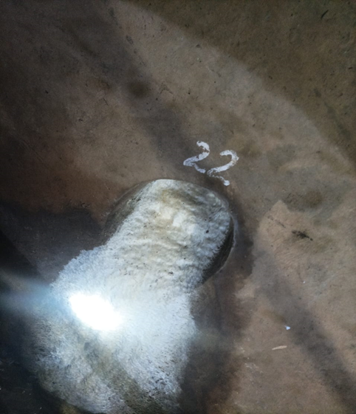
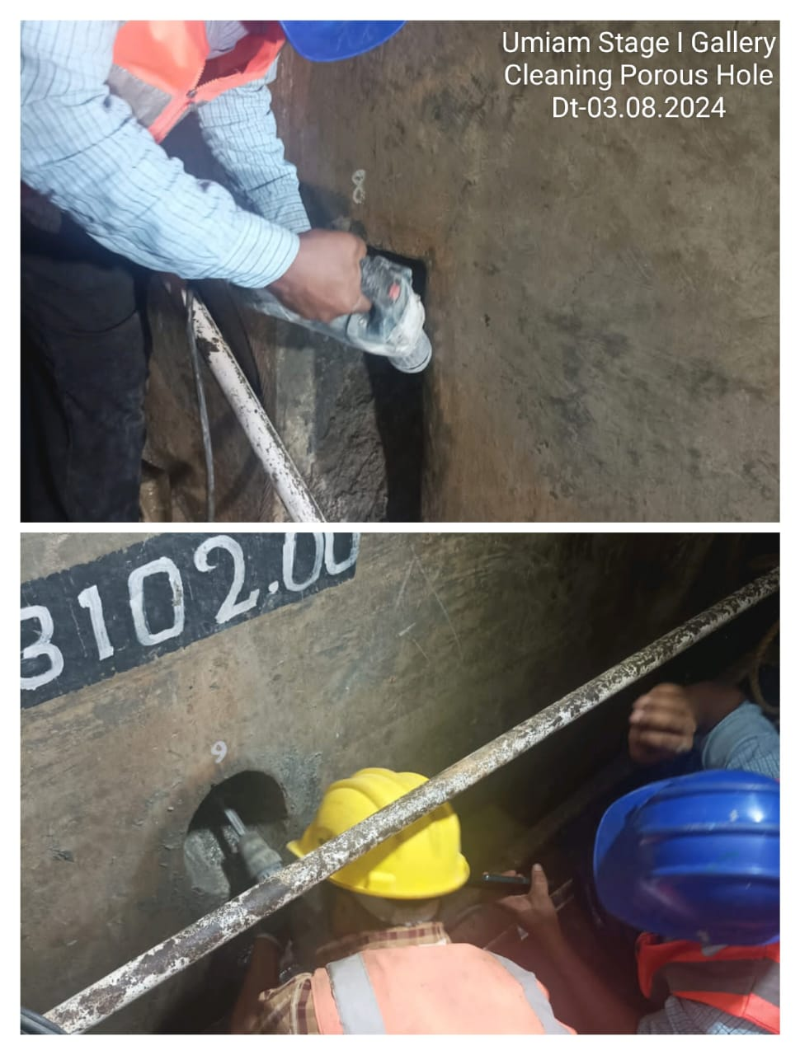
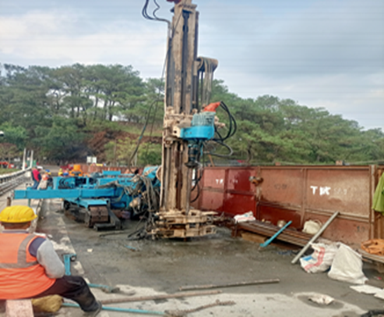
Drilling/ Reaming of Formed drains
Calcinated deposits
kink
Formed drains cleaned up to kink level by re-drilling from top
Tools cleaning/reaming of Vertical porus pipes from bottom to kink

Slide 10
Scraping of bituminous layer over the dam top
An additional item of work i.e removing of the existing damaged bituminous pavement and relaying it with M40 concrete
An Assistant Professor from IIT Guwahati was engaged as Consultant for the Spillway Bridger and rehabilitation of dam roadway
Concreting was taken up during the night where less traffic is moving

Slide 11
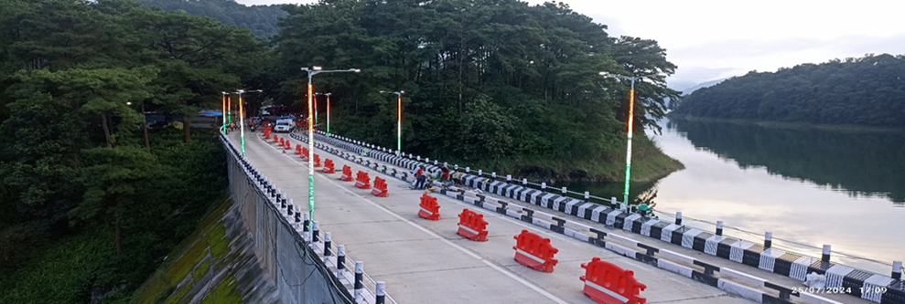
Relaying with M40 cement concrete over the dam top with 24x7 working
Concreting done during night hours when traffic is less

Slide 12
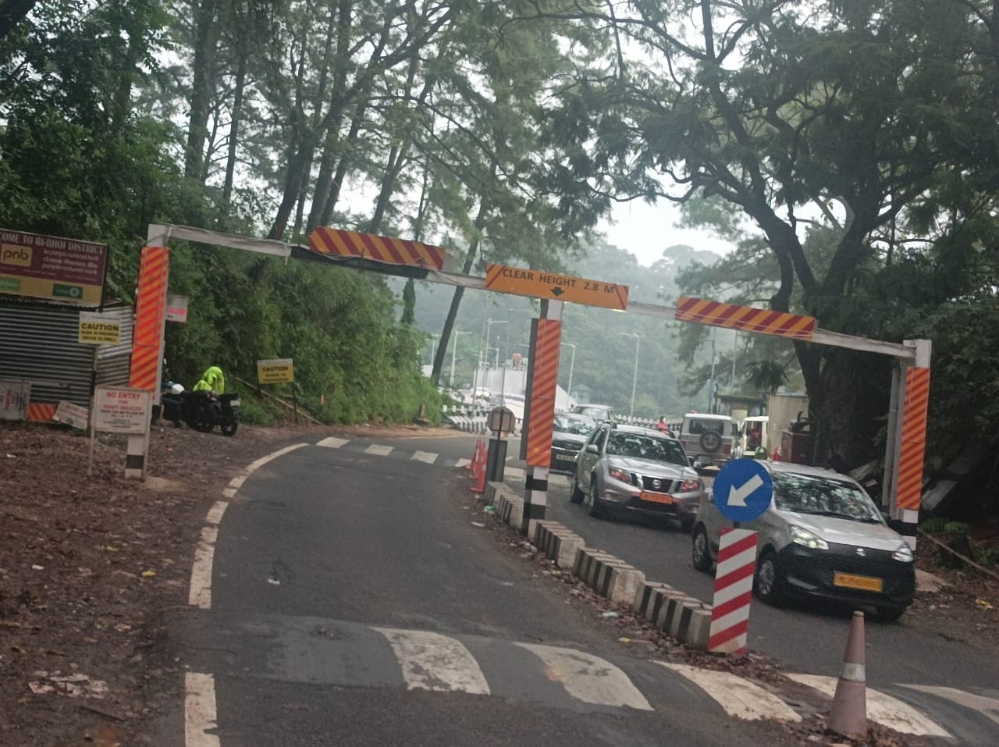
Open to Light vehicular Traffic of upto 9MT and of 2.8m Height from 30th July 2024

Slide 13
MAJOR HYDRO-MECHANICAL WORKS CONTRACTOR: M/s MULTITECH ENGINEERS
Replacement of Rubber Seals for Radial Gates
Painting of radial gates and other components of radial gates
Providing of stairs to Hoisting platform
Providing of Catwalk way connecting from pier to Pier at trunnion Assembly level including safety Railing. for Radial Gates
Replacement of Intake Gate, including hoisting arrangement and control panel

Slide 14
Replacement of Rubber Seals for Radial Gates & Painting of U/S of Radial Gates
Water level required to be brought down to Crest level

Slide 15
MYNTDU LESHKA STAGE I DAM

Slide 16
MAJOR HYDRO-MECHANICAL WORKS CONTRACTOR: M/s MULTITECH ENGINEERS
Rehabilitation of Spillway Radial gate No.1 and Hoists.
Replacement of top, side and bottom seals arrangement for all 7 gates
Painting of Sluice Radial Gates with Epoxy anticorrosive paints inclusive 1 (one) coat of epoxy primer

Slide 17
Challenges in Replacement of top, side and bottom seals arrangement for all 7 gates
1
Hydro-Mechanical Expert engaged since no experienced Hydro-mechanical Engineers
2
Complexities in replacement of wiper and Corner seals being taken care by the HM Expert with the Contractor
3
Leakage observed after gates are operated at a certain height to pass off the flood
4
Proposal for Replacement of Radial Gates

Slide 18
Rehabilitation of Spillway Radial gate No.1 and Hoists.
Replacement of both Hydraulic hoist cylinders (2 nos,) and power pack
Testing and commissioning of new power pack along with hydraulic hoists yet to be conducted.

Slide 19
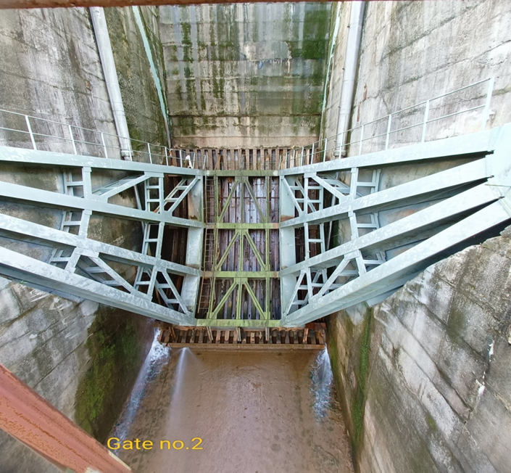
Replacement of top, side and bottom seals arrangement Radial Gate No.2
Leakage from Top, side and bottom
After seal replacement and operation to regulate the inflow

Slide 20
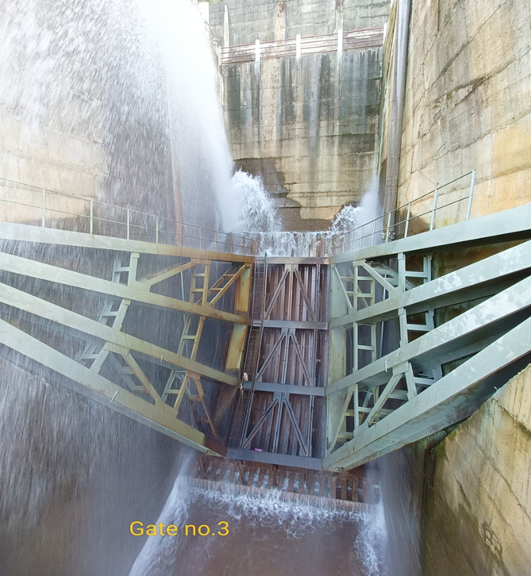
Replacement of top, side and bottom seals arrangement Radial Gate No.3
Leakage from Top, side and bottom
After seal replacement and operation to regulate the inflow

Slide 21
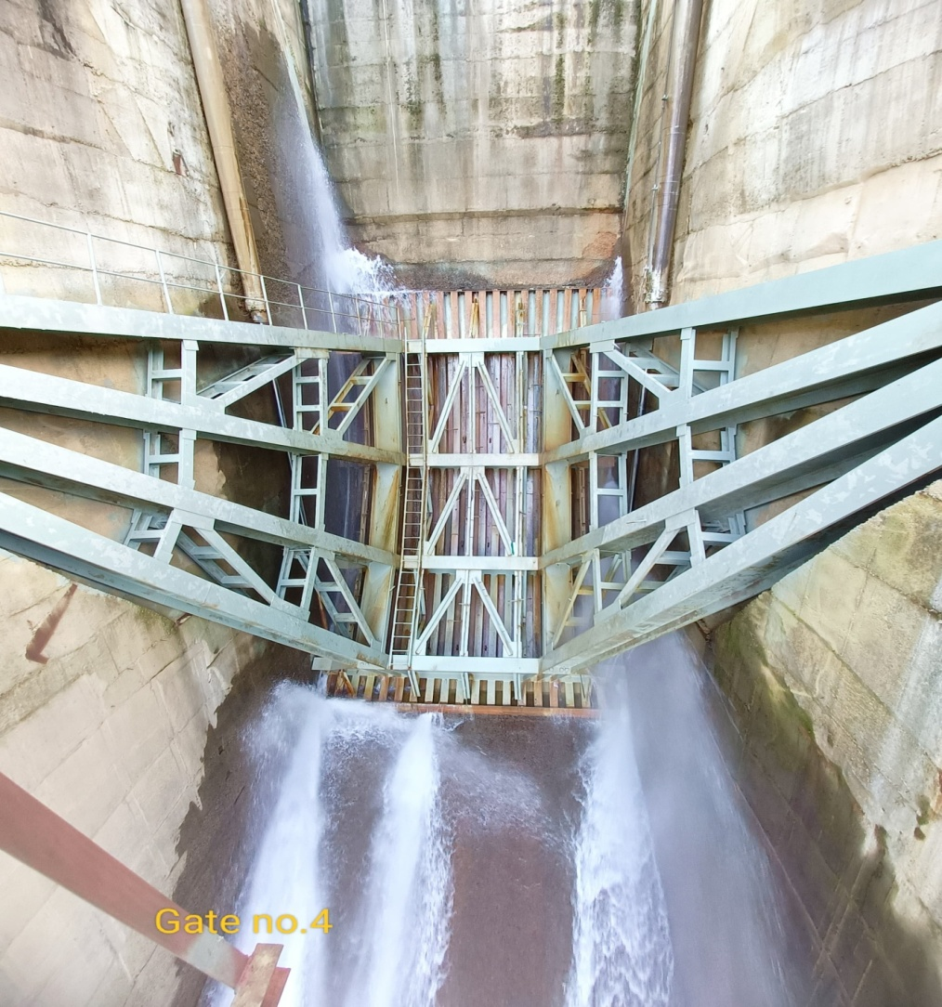
Replacement of top, side and bottom seals arrangement Radial Gate No.4
Leakage from Top, side and bottom
After seal replacement and operation to regulate the inflow

Slide 22
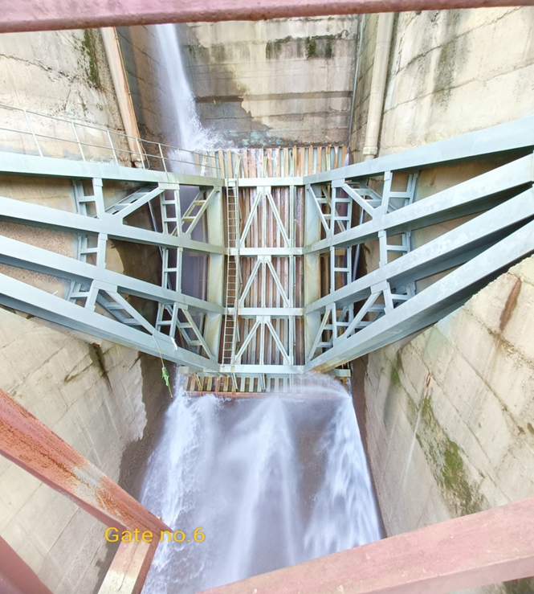
Replacement of top, side and bottom seals arrangement Radial Gate No.6
Leakage from Top, side and bottom
After seal replacement and operation to regulate the inflow

Slide 23
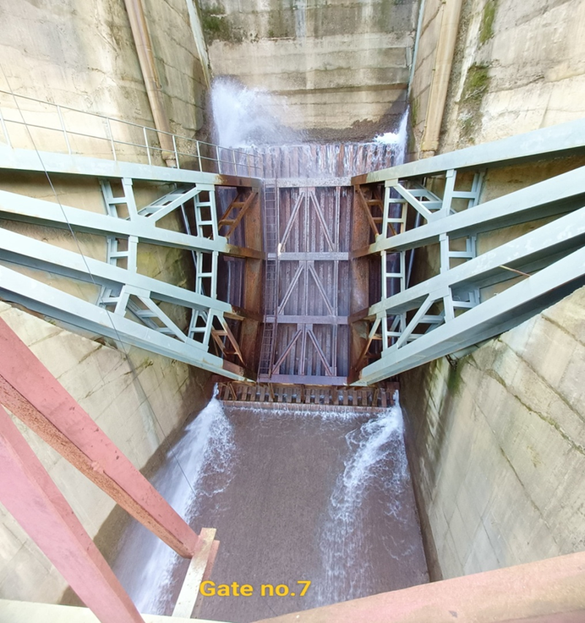
Replacement of top, side and bottom seals arrangement Radial Gate No.7
Leakage from Top, side and bottom
After seal replacement and operation to regulate the inflow

Slide 24
Problems with lifting of Radial Gates
Sluice Radial Gate No.2. touching the top sill beam when opens only upto 3m Height
1

Slide 25
Problem with replacement of wiper seals
Replacement of top seals
Unable of replacement of wiper seals due to inability to lift Gates fully and no dogging arrangement in place

Slide 26
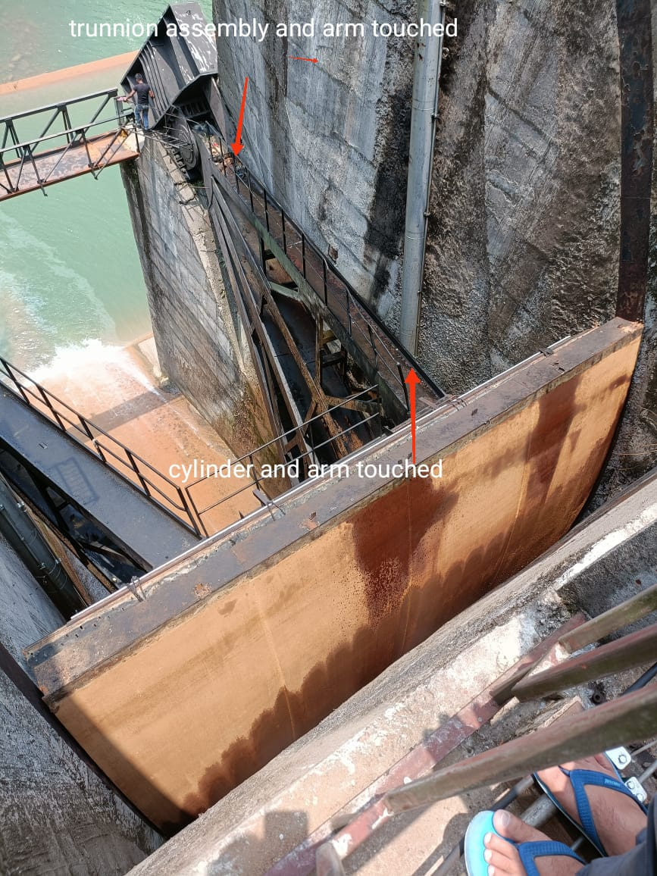
Obstruction during operation of Radial Gates
Trunnion assembly and arm touched
Cut in Yoke girder
Hydraulic Cylinder and Arm touched

Slide 27
Maximum Height of Gate opening

Slide 28
Guide Plates misaligned and top of gate touching manifold of hydraulic hoist on opening upto 9m Ht

Slide 29
Guide Plate misaligned and top of gate touching manifold of hydraulic hoist after opening upto 9m Ht

Slide 32
VISIT OF CPMU
Project Director DRIP
Director DRIP
3rd Party QA&QC

Slide 33
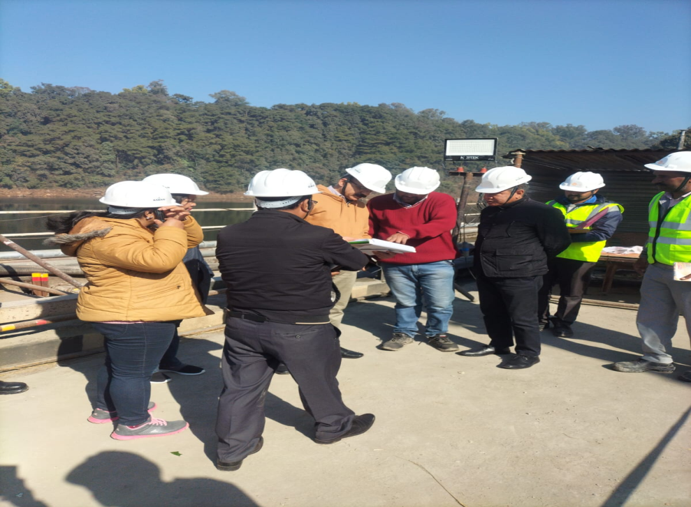
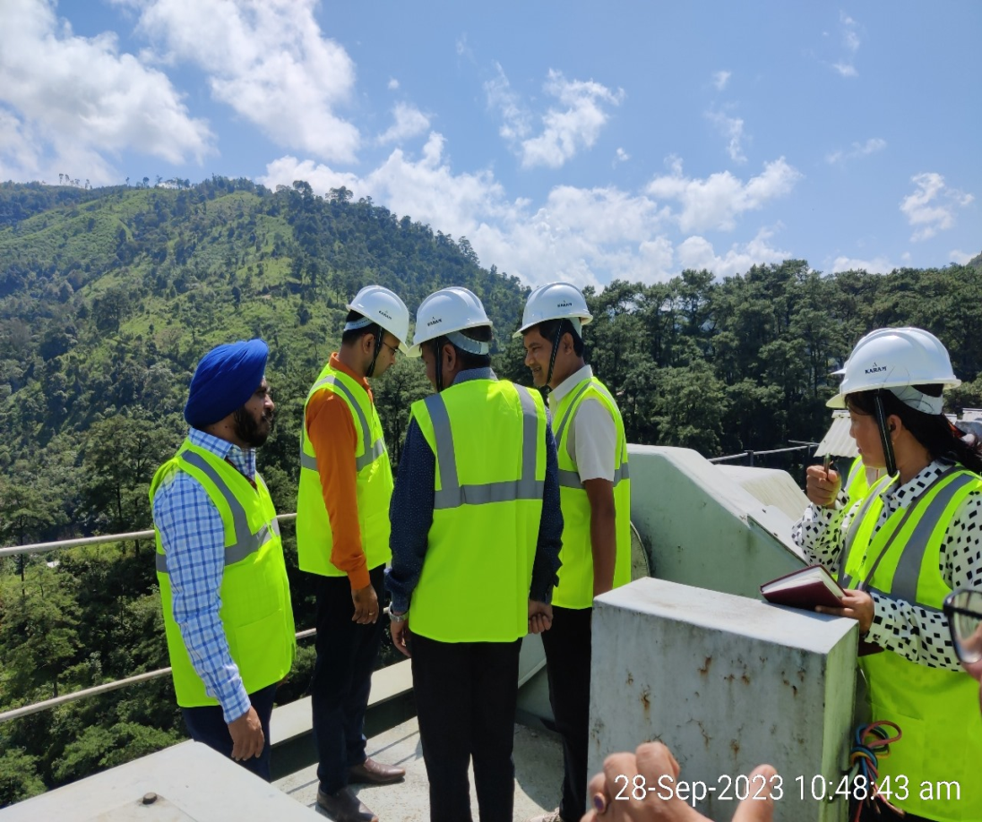
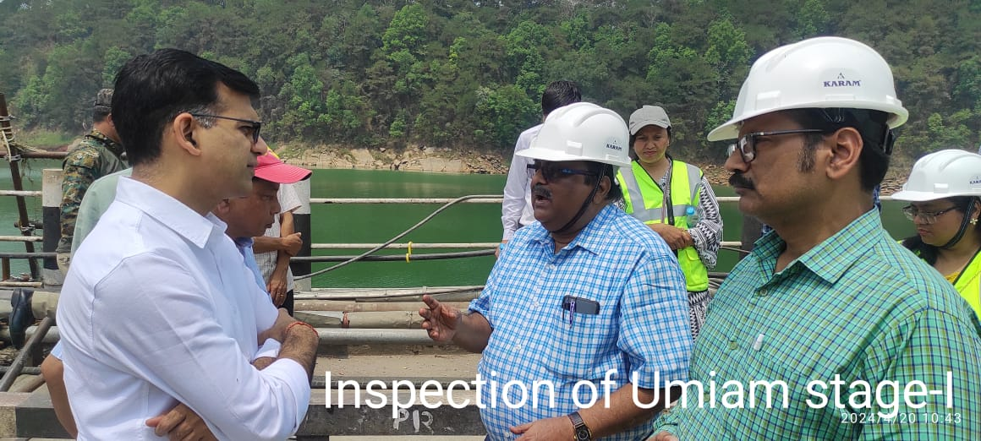

Slide 34
THANK YOU

