Slide 1

Development and implementation of EAP for Tilaiya Dam - A Case Study
ABHISHEK SHUKLA
DAMODAR VALLEY CORPORATION, INDIA

Slide 2
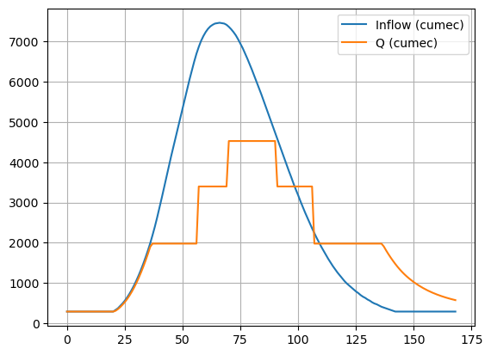
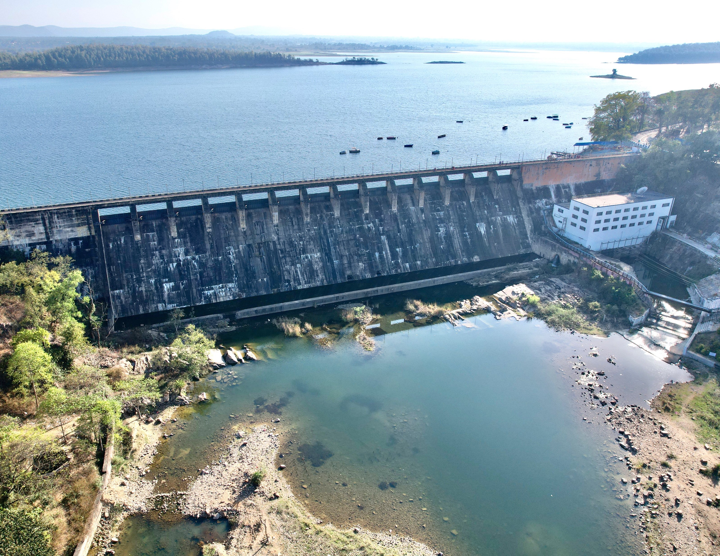
Emergency with respect to Dams
Dams: A structure that holds massive amount of water – for multiple uses.
Flood Control Purpose

Slide 3
Emergency with respect to Dams

Slide 4
Emergency Action Plans (EAP) for dams
Formal plan that IDENTIFIES potential emergency conditions at a dam and prescribes STANDARD OPERATING PROCEDURE for coordination among all the agencies.
To PREVENT dam failure.
To MINIMIZE THE LOSSES, if failure occurs/Large Releases.
EAP is the SOLUTION to the gap in information flow during emergencies but not a SUBSTITUTE for proper maintenance or remedial construction.
Dam Safety Act 2021 mandates dam owners to prepare and implement EAP for each specified dams by Dec-2026.

Slide 5
EAP for dams – Key requirements
Event Detection & Emergency Level Determination – Assessment of the situation to determine the level of threat.
Notification – All concerned
Actions – REMEDIAL (Save the dam)
– EVACUATION (for the possible inundated area)
CLEAR description of Roles & Responsibilities.
SIMPLICITY of Document

Slide 6




EAP for dams – Other requirements
List of Consultant, Suppliers & Contractors to contact in case of emergency for immediate actions.
Steps for re-evaluating dam condition for a specific event.
Pre-determined Public Announcement
Media for Spreading awareness and information.
Revision & Update

Slide 7
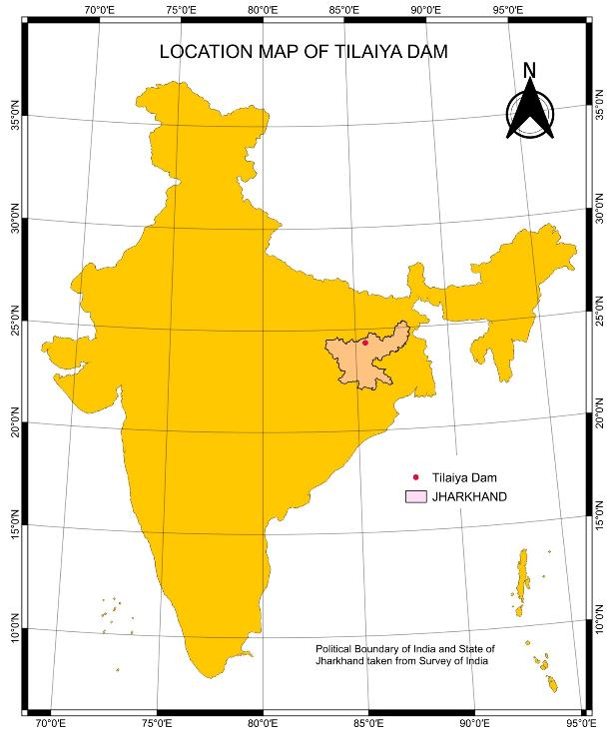
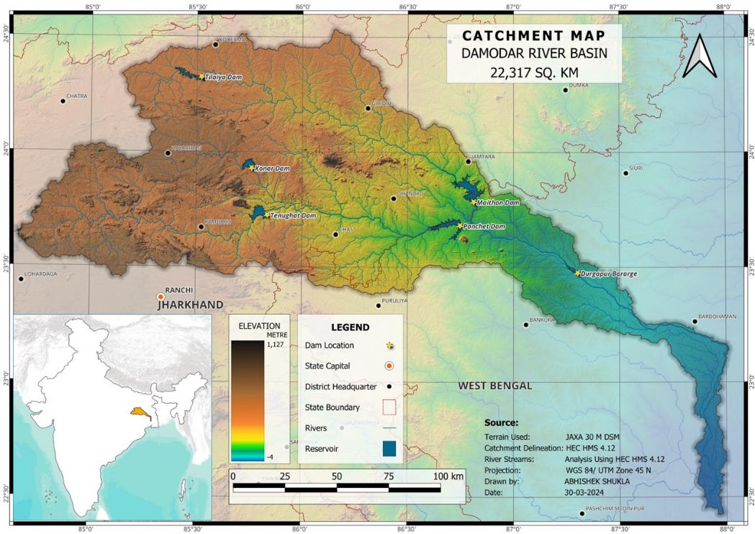
EAP for Tilaiya Dam

Slide 8
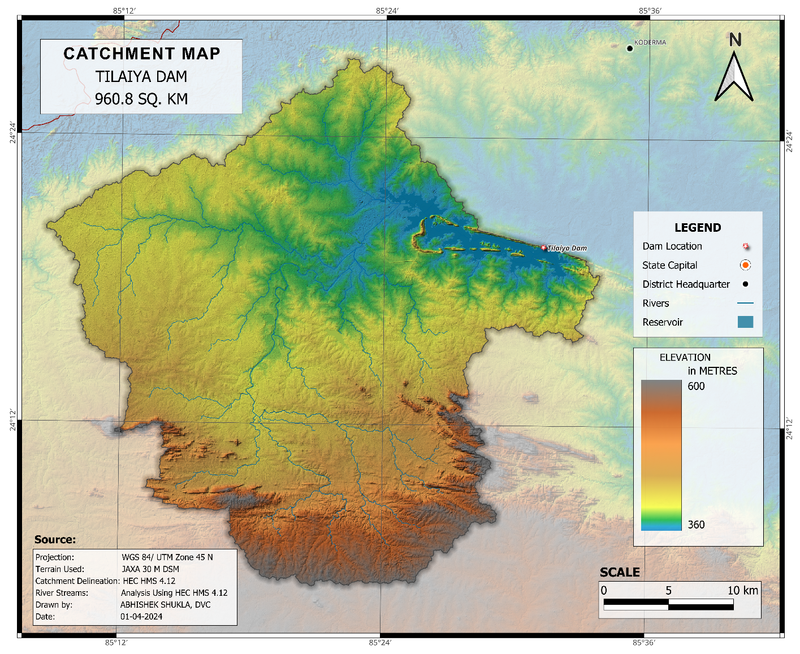




EAP for Tilaiya Dam
Koderma & Hazaribag districts of Jharkhand
Dedicated to the Nation by Pt. Jawahar Lal Nehru on 21-02-1953
Built across river Barakar
Catchment Area: 960 sq. km
Inflow Design Flood: 5777 m³/s
Probable Max. Flood: 4455 m³/s
Type: Straight Concrete Gravity
Height: 39.01 m
Length: 365.76 m
Storage (at FRL): 376.95 MCM

Slide 9
EAP for Tilaiya Dam
Estimation of worst-case inflow in dam – Design Flood review
Identification of Failure causing events & Emergency-level determination.
Dam-breach analyses for different failure scenarios.
Development of Inundation maps for different failure and non-failure scenarios.
Flood Hazard and Vulnerability assessment for each settlement.
Developing Evacuation Plans (Maps & Tables) including designated shelter location
Notification and Communication to Concerned Authorities/ Media etc.

Slide 10
Consequence Estimation
Release corresponding to Historical maximum inflow - BASELINE
Large-controlled release from dam without dam failure – this corresponds to release from the dam corresponding to the Design flood inflow, as per the existing flood operation guideline of Tilaiya dam.
A non-flood dam failure caused by any external loading with the reservoir at top of conservation level (i.e. at 1210’ or 368.81 m) leading to breaching and uncontrolled release of impounded water.
Dam failure during large inflow (corresponding to Design flood Inflow) under gate operation scenario as per the existing flood operation guideline of Tilaiya dam, once reservoir level crosses FRL, i.e. 1222’ or 372.46 m, leading to breaching and uncontrolled release of impounded water. – WORST CASE SCENARIO

Slide 11
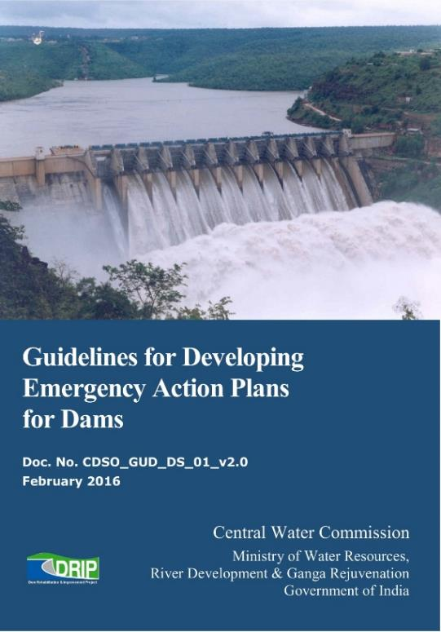
The Guidelines
The guidelines recommends using Inundation maps for evacuation planning.
During a dam breach simulations, multiple inundation maps are prepared giving information like:
time of arrival of flood waves
velocity of the flood wave,
depth of flood, etc.
Since, the responsibility for evacuation lies with the Disaster Management Authorities (DMAs), simply sharing the inundation maps may not serve the purpose of EAP

Slide 12
Flood Hazard Mapping
Tools used
HECRAS (2D Unsteady Flow)
QGIS, Google Earth Pro
JAXA DEM (30 m)
Land Cover Layer (Sentinel 10 m, 2021)
Input Data
Reservoir Elevation – Capacity, Inflow
Gate Details : Type, Numbers, Size, Location
Breaching Conditions – Froelich, 2016
Administrative Boundary: SOI
Schools, Hospitals, Police Station: JSAC
Open source data – Population data, Road, Railways

Slide 13
An effective approach for evacuation
Depth of inundation
Velocity of flood wave
Vulnerability Map
Mark and identify the settlements
Depth x Velocity
Inundation cum evacuation maps with
Shelter points and evacuation routes
Flood Arrival Time
Processing in GIS environment
Ref: Guidelines for Flood Risk Mapping
With Evacuation Table to supplement the map.

Slide 14
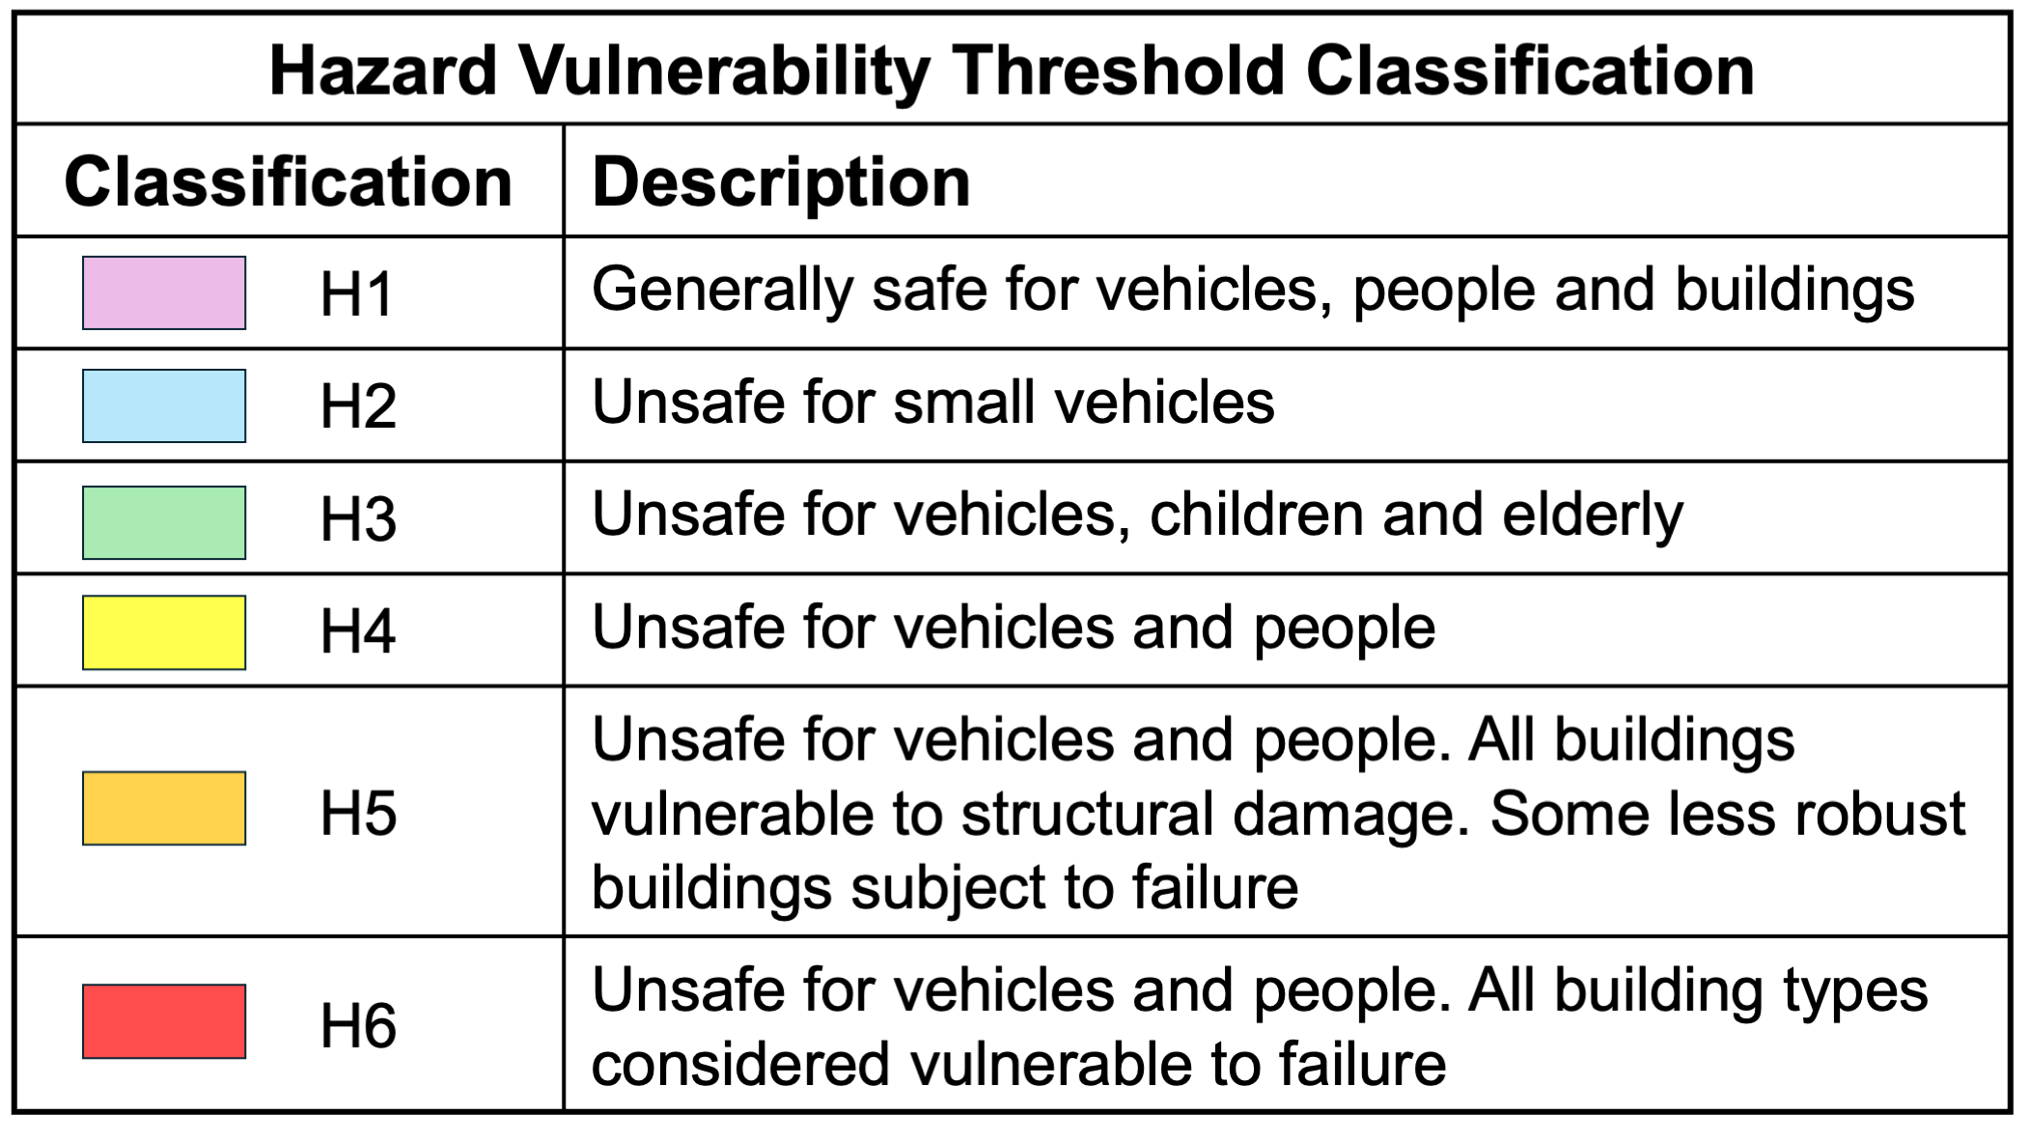
An effective approach for evacuation
GIS PROCESSING
Time of Arrival of Flood Wave
Settlements
Population Data
Other Data
X

Slide 15
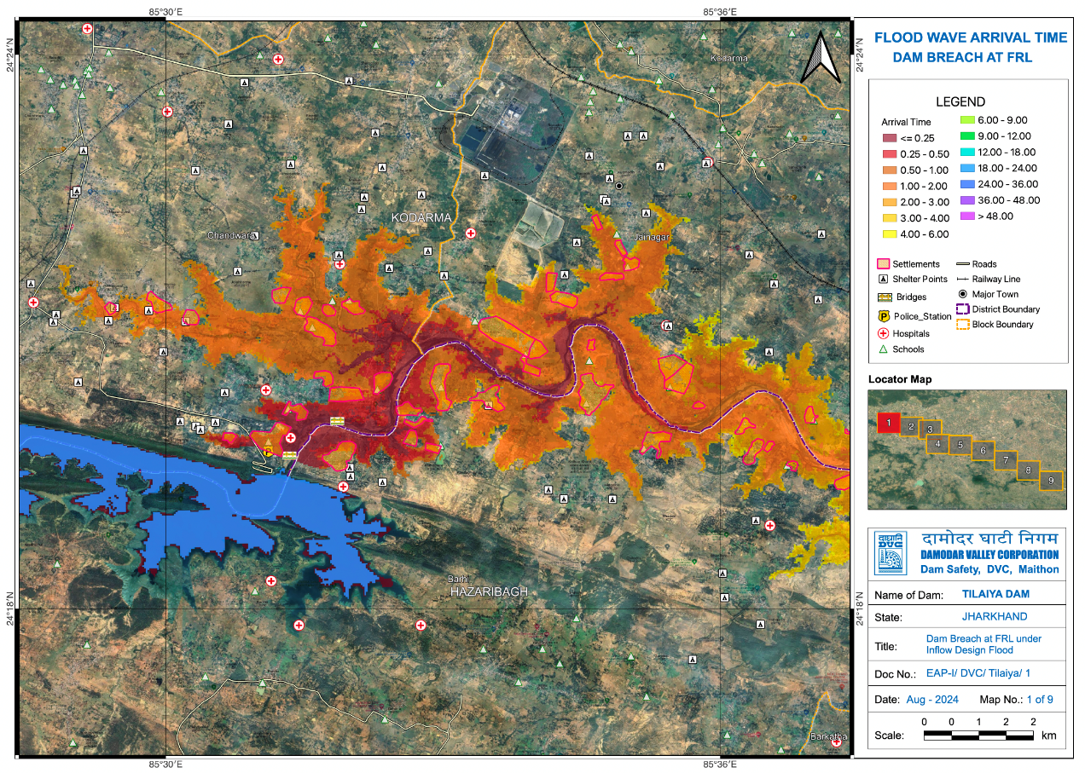
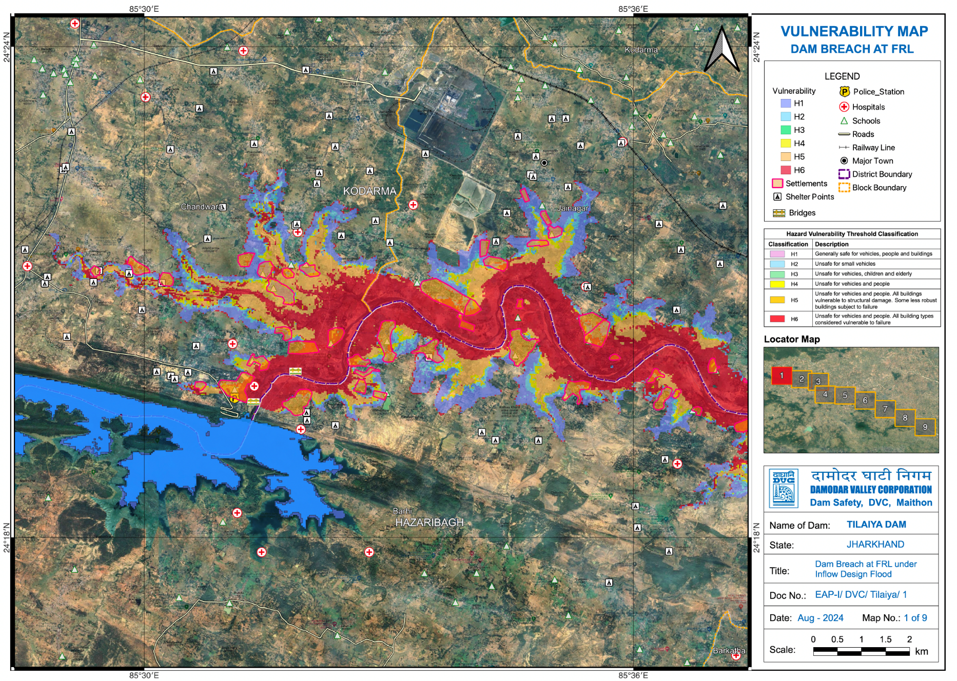
Consequence Estimation
Failure at FRL

Slide 16
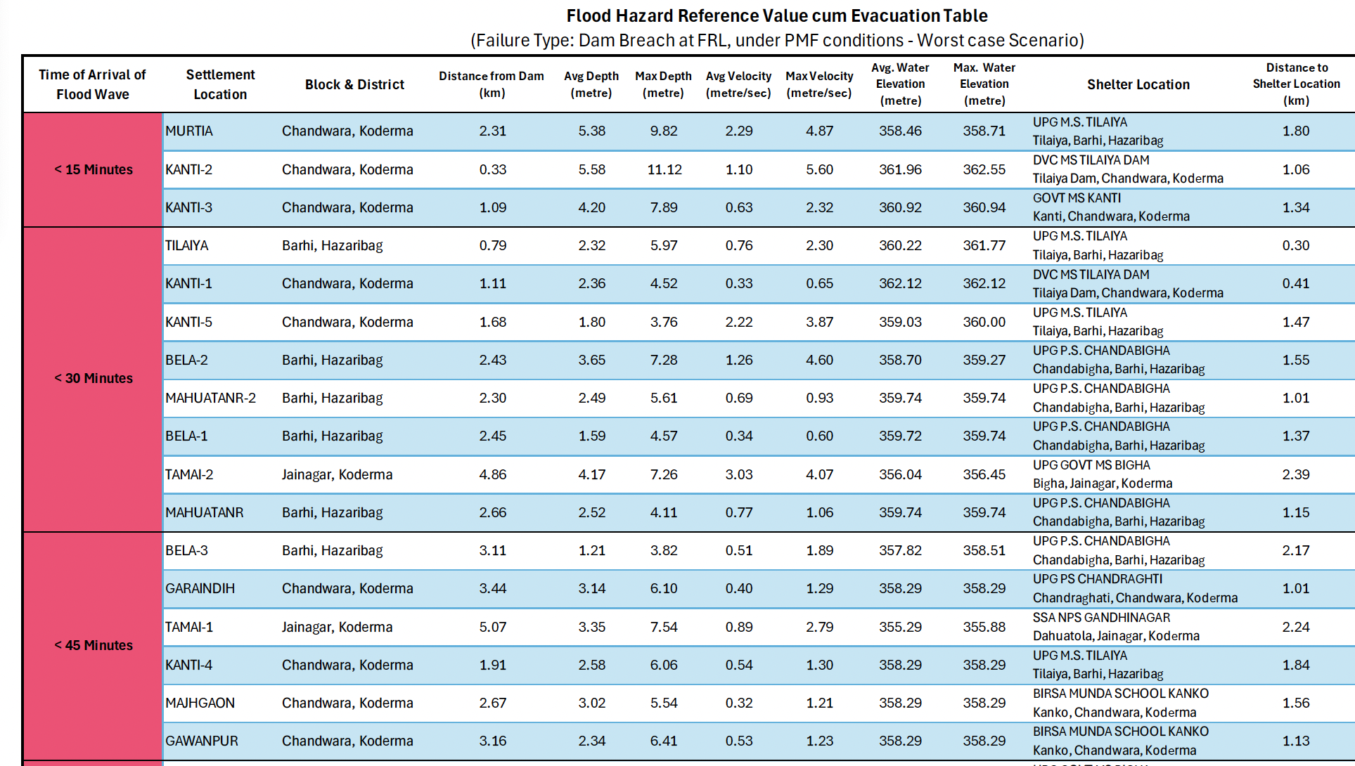

Slide 17
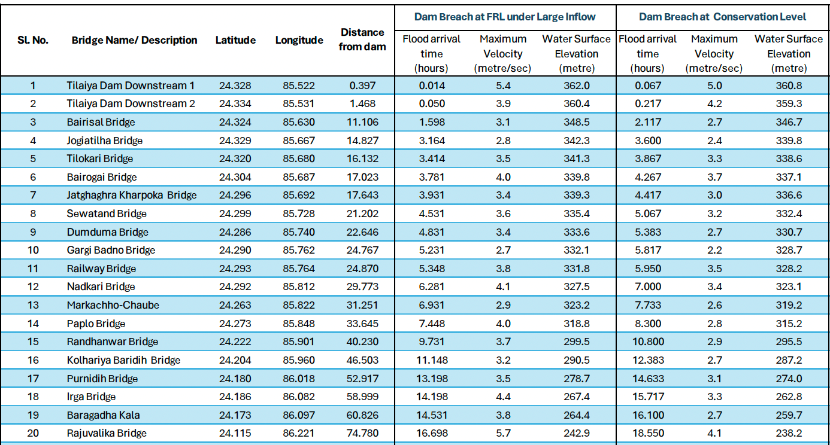
Affected Bridges

Slide 18
Affected Areas under Worst Case Scenario
State | District | Affected Blocks
Jharkhand | Hazaribagh | Barhi, Barkatha, Chalkusha
 | Koderma | Chandwara, Jainagar, Markaccho
 | Giridih | Birni, Sariya, Dumri, Giridih, Pirtanar, Gande
 | Dhanbad | Tundi, Purbi Tundi, Chirkunda-Nirsa (Warning only)
 | Jamtara | Narayanpur, Jamtara (Warning Only)

Slide 19
Notification & Communication
Notification flowchart for 3 level of Emergency.
Who will contact whom?
Communication Sequence.

Slide 20
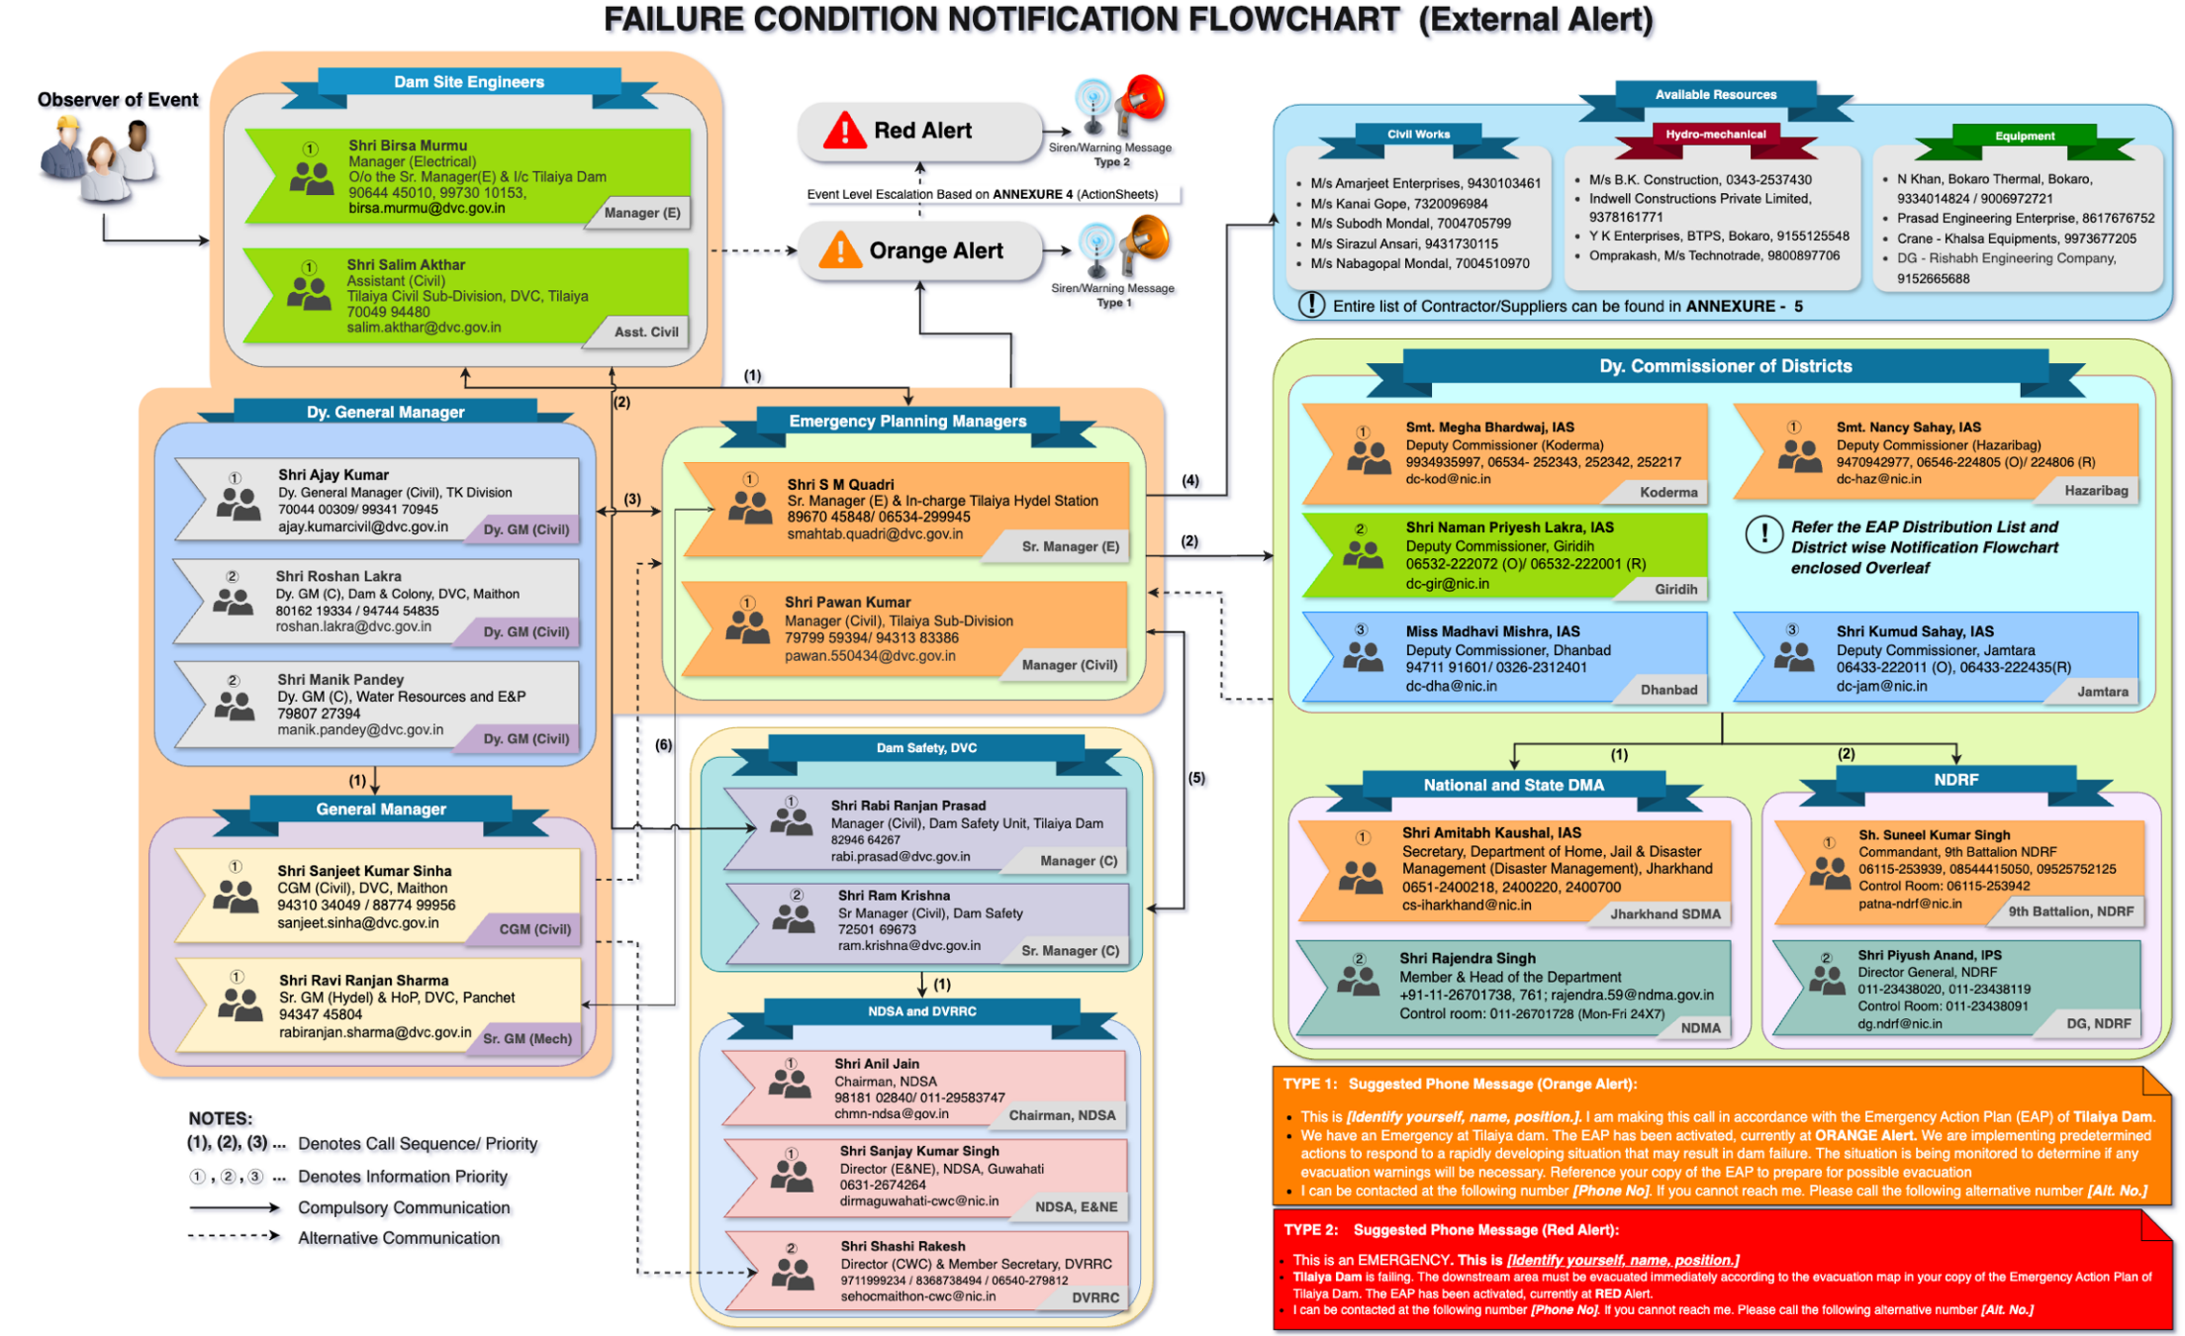
Notification Flowchart
ALERT & FAILURE CONDITION

Slide 21
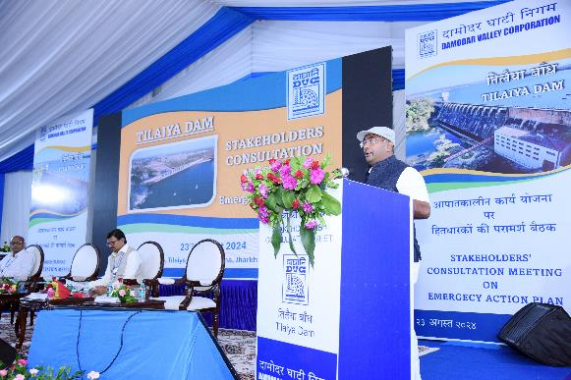
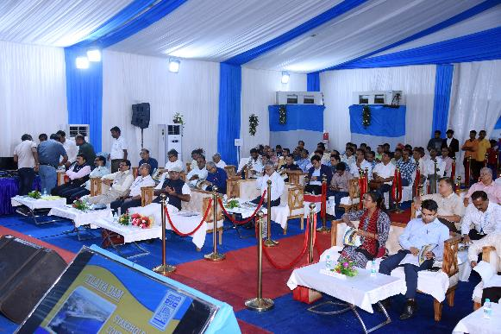
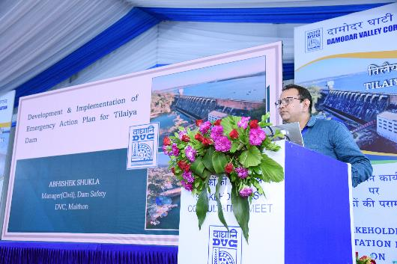
Implementation
Stakeholders Consultation process – 23rd August 2024
To familiarize Stakeholders about the document
To seek inputs for improvement of the document including Disaster Mitigation Authorities, Early Warning Providers, Village representatives, etc,

Slide 22
Implementation
Specific Input requested:
District Disaster Management Officer(s) name and contact details for incorporation in District – wise Notification flowchart.
Block-wise name of Officials (along with contact details) required for incorporation in the Evacuation Table.
Incorporation of EAP in District Disaster Management Document of Districts.

Slide 23
References
Guidelines for Developing Emergency Action Plans for Dams, Feb’ 2016, CWC
Guidelines for Mapping Flood Risks Associated with Dams, Jan’ 2018, CWC
Flood estimation Report for Lower Ganga Plain – Subzone 1(g) (Revised), Nov. 1994, CWC.
Froehlich, David. An Empirical Model on Embankment Dam Breaching, Feb, 2017, Third National Dam Safety Conference, IIT Roorkee.
Manual on Estimation of Design Flood, March’ 2001, CWC, New Delhi.
PMP Atlas for Ganga Basin, RSMI

Slide 24

THANK YOU

